Slide 1
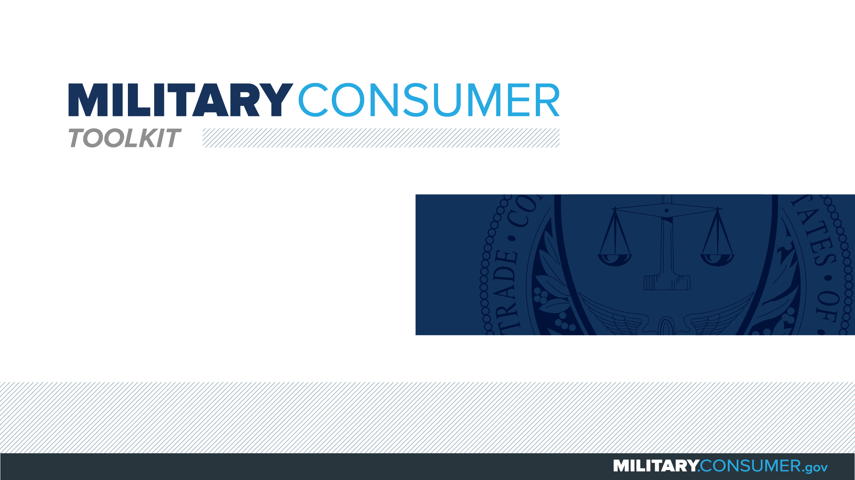

Slide 2

Why This Matters
Studies show that, on average, military families have higher amounts of debt and fewer assets than civilians
Challenges of military life can affect servicemembers’ finances:
  Frequent transition and changes
  Many servicemembers have little financial experience
  Decisions have long-term effects
Getting the know-how is key to making smart financial decisions
Notes:
[Presenter: Use this slide to set up the rest of your presentation, following it with slides that focus on the specific topics you want to cover.]
Suggested Script:
Today I’d like to talk about financial readiness – why it’s important and what you need to know to achieve it.
According to the National Foundation for Credit Counseling, active members of the military, veterans and their families have higher amounts of credit card debt and fewer assets than civilians. This means that military families are less equipped than their civilian counterparts to have the money they need for a secure future.
This is caused by many factors. As you know, military life is full of events and transitions, and each of these events brings the need to make important financial decisions. Unfortunately, many servicemembers – especially those without much financial experience – lack the information they need to make the right choices. This is particularly scary because many of these decisions can have long-term effects on a servicemember’s security clearance, mission readiness and family life.
Understanding your finances is your first line of defense. That’s why I’m here today – to help provide you with practical tips and information that will help you feel prepared to make these critical decisions.

Slide 3
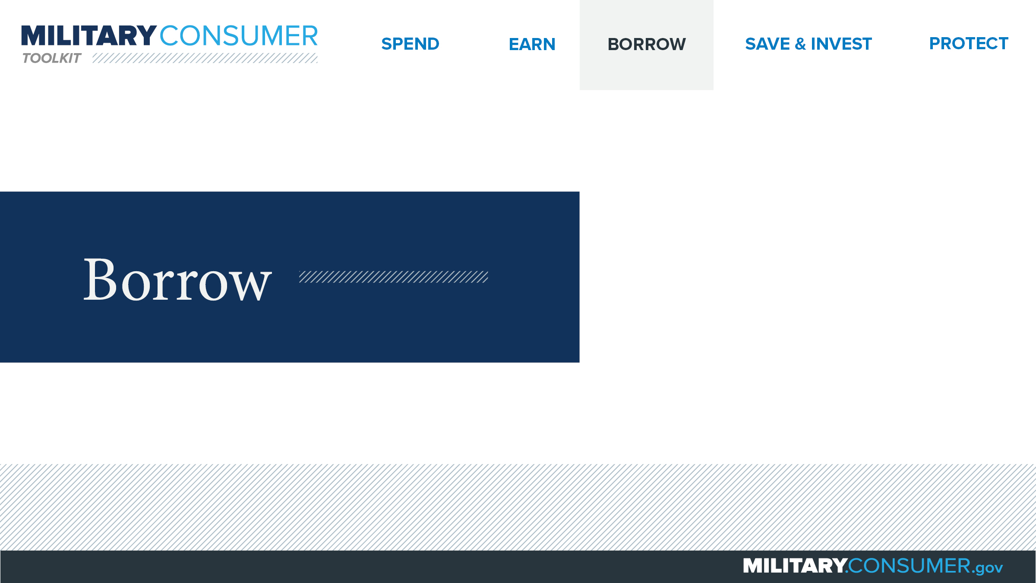
Notes:
Suggested Script:
Credit can be a great tool for helping you achieve your financial goals. But it has to be used responsibly, or else debt can become a big problem.
Today, we will learn about [PRESENTER: CUSTOMIZE TO SUIT THE TOPICS YOU WILL COVER] borrowing money – specifically, how to use credit and tips for dealing with debt.

Slide 4

Need Money in a Hurry?
Payday and car title loans
  Charge extremely high rates
  Should be last resort
Better alternatives
  Bank or credit union loan
  Credit card
Get help
  Talk to PFM
  Call Military OneSource – 1-800-342-9647
Notes:
Suggested Script:
There may be times when you need to get money fast. And you may have seen advertisements from companies that make quick loans, like payday or car title lenders. While these can seem like a great option, these companies can be very expensive and charge extremely high interest rates – up to 36 percent for servicemembers. They should really be considered a last resort choice.
Think about whether you can get money from somewhere else. Consider a loan from your bank or credit union. Depending on the situation, even using a credit card may be better than a payday loan.
Also, know that there’s help for you if you’re facing financial trouble. Talk to your Personal Financial Manager (PFM) about your choices and options. You can also call DoD’s Military OneSource help line, 24 hours a day, seven days a week. The phone number is 1-800-342-9647, and they can help you with:
Helping you get more time to pay your bills.
Potentially getting you an advance on your paycheck.
Connecting you with a certified credit counselor who can help make a plan for managing your money.
Getting help from a military relief society.

Slide 5


