Slide 1
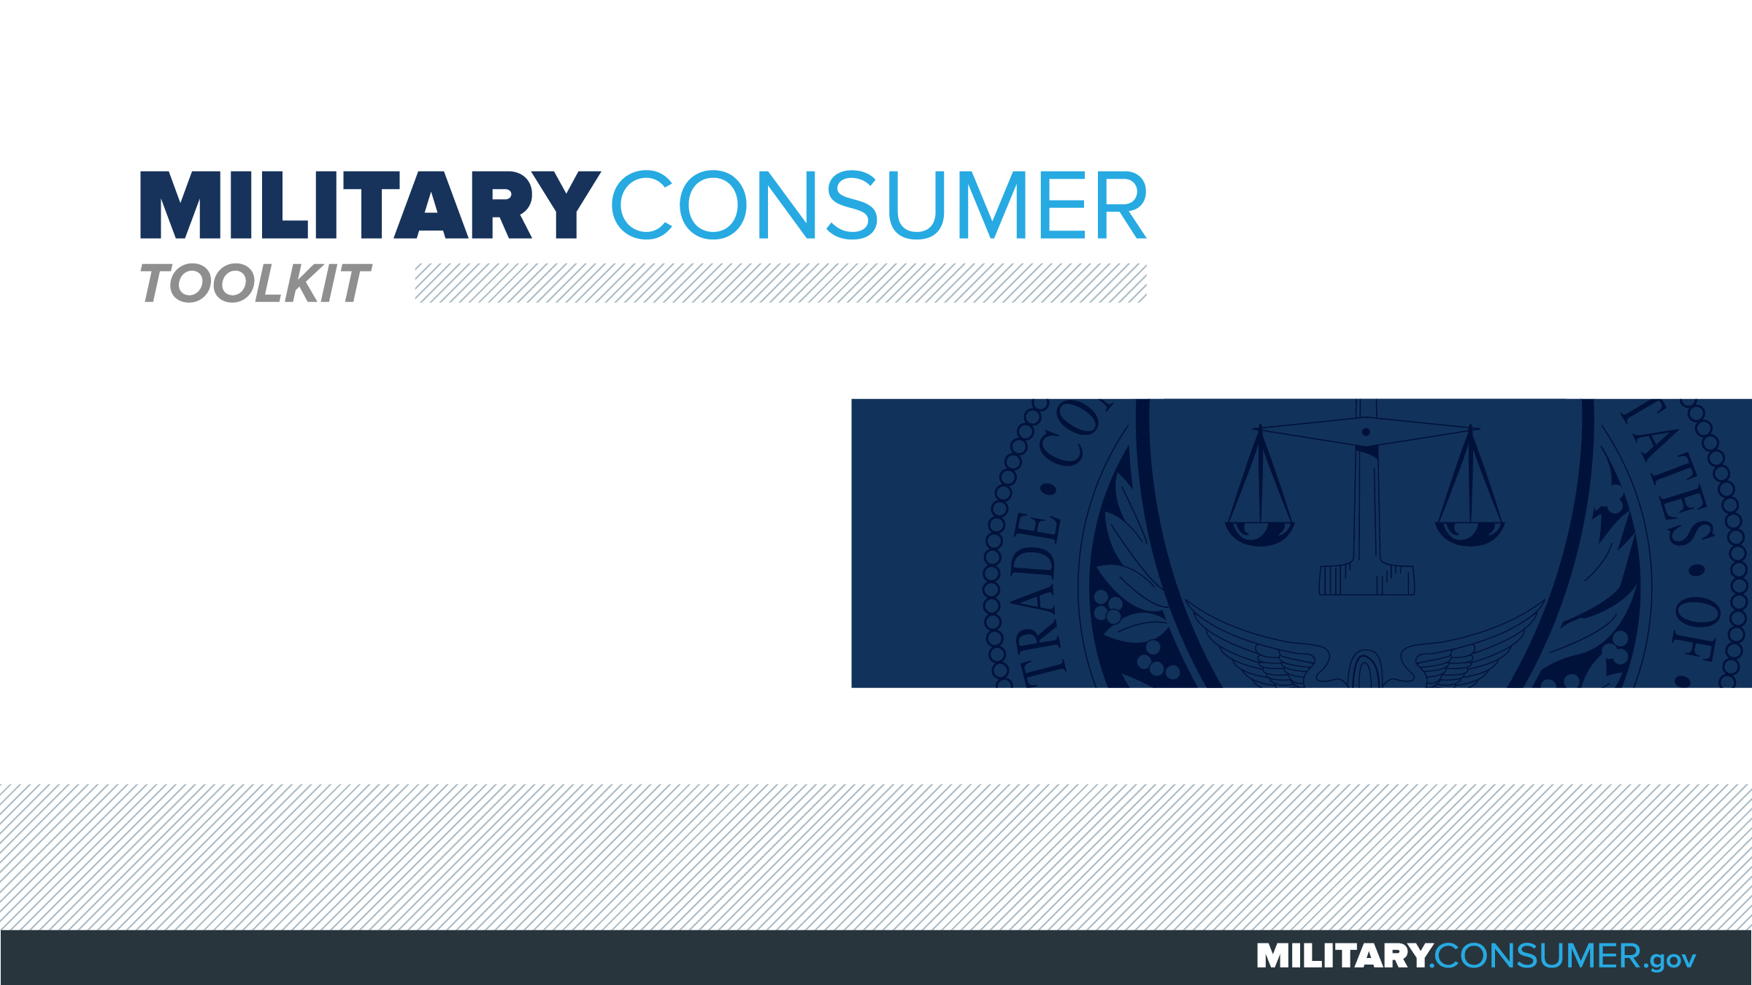

Slide 2
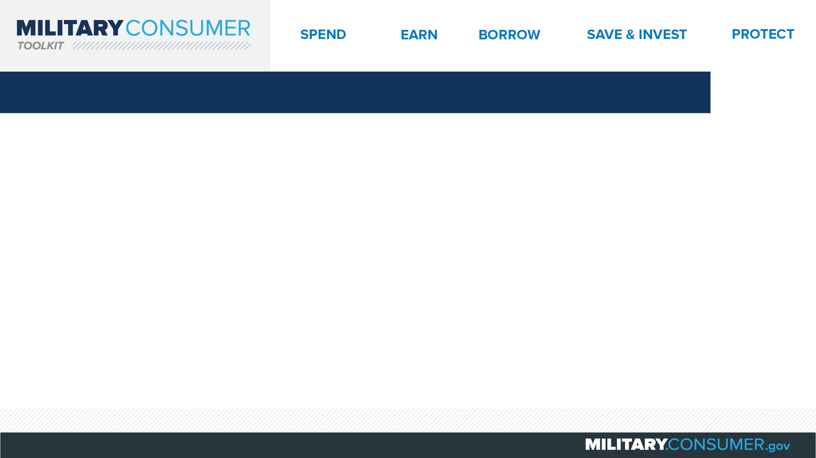
Why This Matters
Studies show that, on average, military families have higher amounts of debt and fewer assets than civilians
Challenges of military life can affect servicemembers’ finances:
  Frequent transition and changes
  Many servicemembers have little financial experience
  Decisions have long-term effects
Getting the know-how is key to making smart financial decisions
Notes:
[Presenter: Use this slide to set up the rest of your presentation, following it with slides that focus on the specific topics you want to cover.]
Suggested Script:
Today I’d like to talk about financial readiness – why it’s important and what you need to know to achieve it.
According to the National Foundation for Credit Counseling, active members of the military, veterans and their families have higher amounts of credit card debt and fewer assets than civilians. This means that military families are less equipped than their civilian counterparts to have the money they need for a secure future.
This is caused by many factors. As you know, military life is full of events and transitions, and each of these events brings the need to make important financial decisions. Unfortunately, many servicemembers – especially those without much financial experience – lack the information they need to make the right choices. This is particularly scary because many of these decisions can have long-term effects on a servicemember’s security clearance, mission readiness and family life.
Understanding your finances is your first line of defense. That’s why I’m here today – to help provide you with practical tips and information that will help you feel prepared to make these critical decisions.

Slide 3
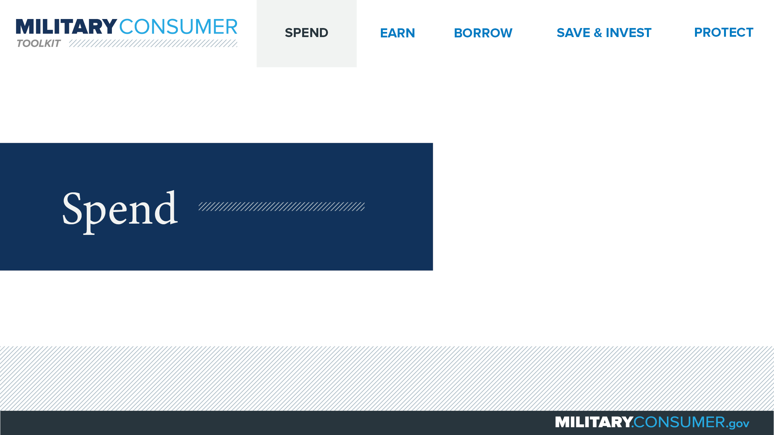
Notes:
Suggested Script:
Spending money is a fact of life. But it’s best to do this in a way that is carefully researched and planned out. When you know where your money is going, you have the power.
Today, we will learn about [PRESENTER: CUSTOMIZE TO SUIT THE TOPICS YOU WILL COVER] people who are available to help you plan your spending, how to create and manage a budget and how to shop smart for purchases ranging from small to large.

Slide 4
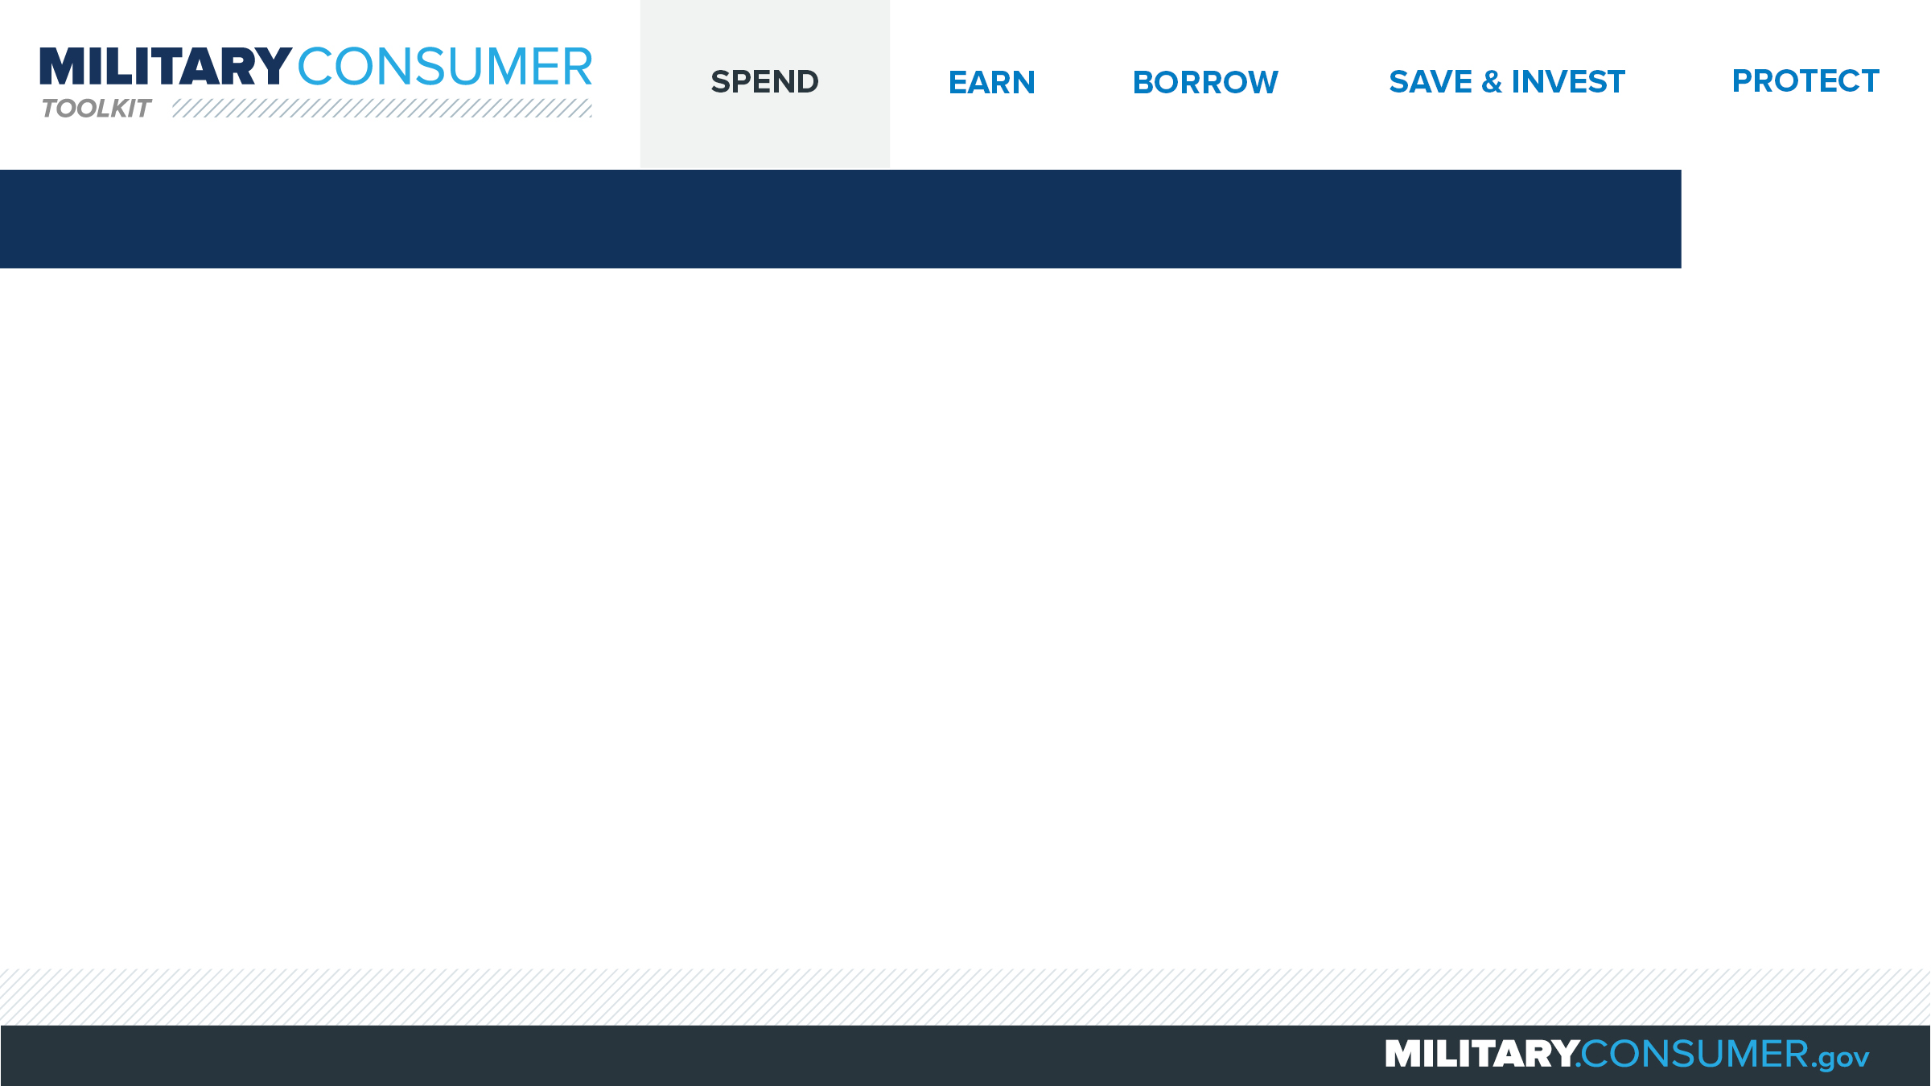
Personal Financial Managers (PFMs)
PFMs provide
  Confidential help
  Counseling
  Free classes
  Emergency financial help
  Free FICO credit score
To find a PFM
  Visit MilitaryInstallations.dod.mil and select
  “Personal Financial Management Services”
  Call Military OneSource at 1-800-342-9647
Notes:
Suggested Script:
(adapt script depending on whether speaker is a PFM, other counselor or someone else in the community.)
It’s important to know that you’re not alone in tackling financial topics. The Department of Defense has financial counselors, including Personal Financial Managers (or PFMs), who are available to help.
Can anyone here tell me what a PFM can help you with?
Working with PFMs is private and confidential. They can help you with things like one-on-one counseling; free classes and seminars on topics like money management, your credit, military savings programs and how to get out of debt; applying for emergency financial help; and getting your free FICO credit score through the FINRA Investor Education Foundation.
You can find a PFM by visiting the military installations website and choosing, “Personal Financial Management Services” or calling Military OneSource at 1-800-342-9647.

Slide 5


