Slide 1
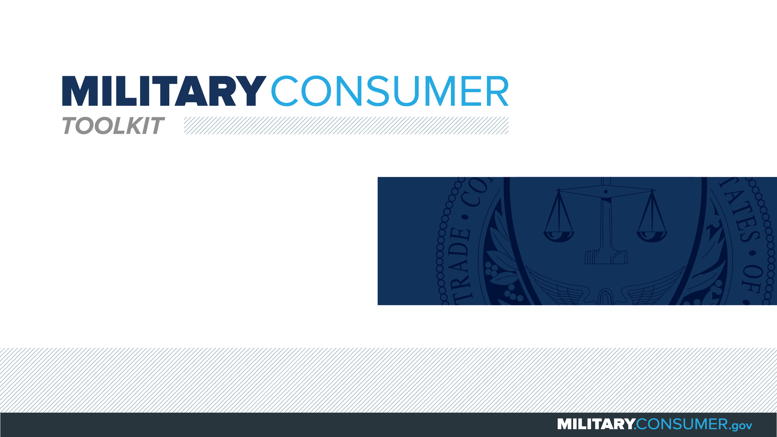

Slide 2
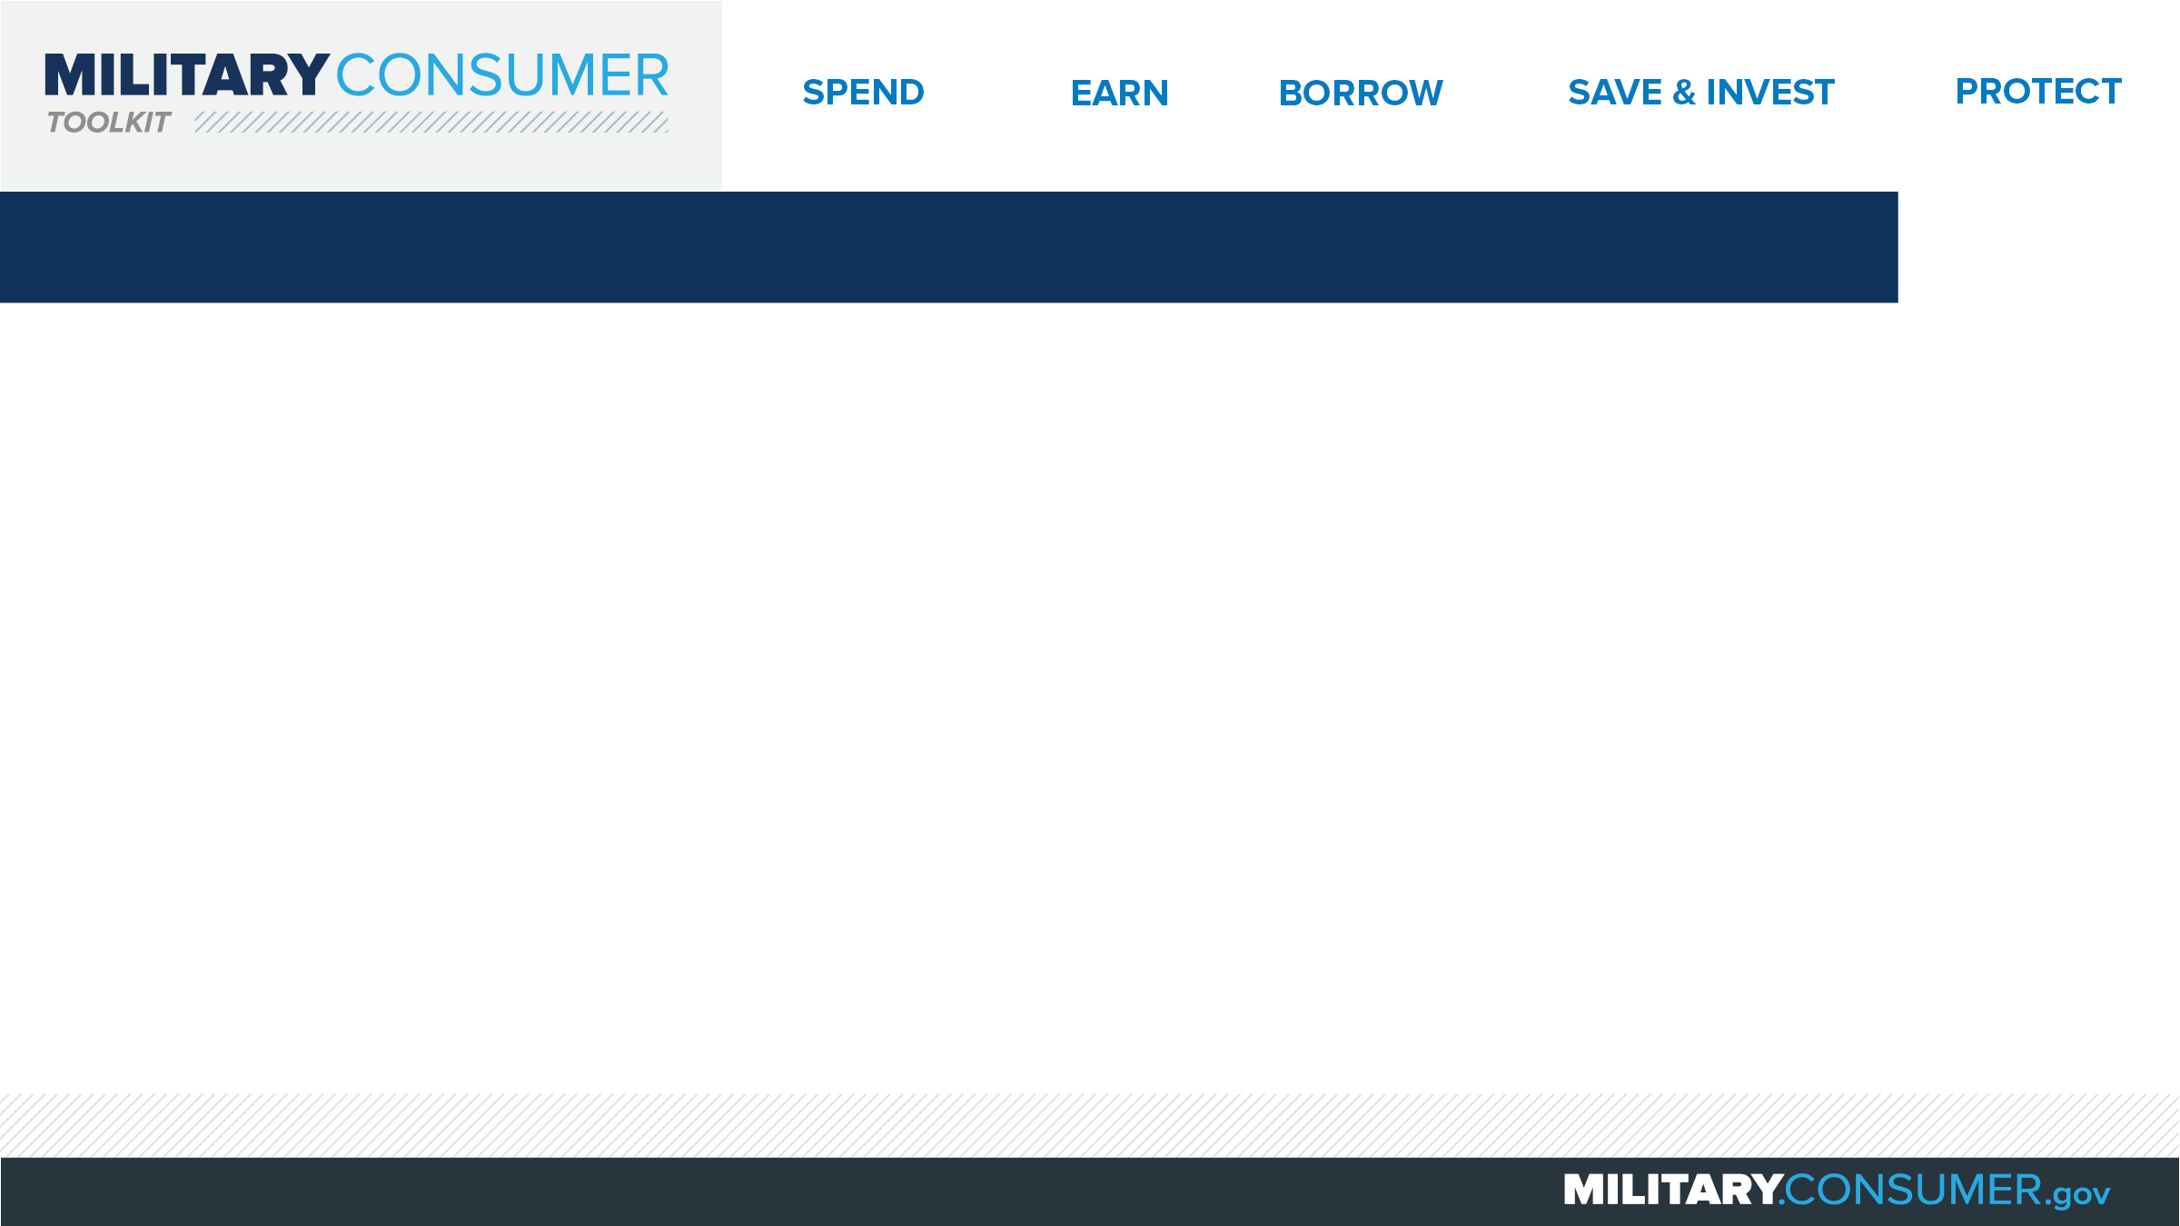
Why This Matters
Studies show that, on average, military families have higher amounts of debt and fewer assets than civilians
Challenges of military life can affect servicemembers’ finances:
  Frequent transition and changes
  Many servicemembers have little financial experience
  Decisions have long-term effects
Getting the know-how is key to making smart financial decisions
Notes:
[Presenter: Use this slide to set up the rest of your presentation, following it with slides that focus on the specific topics you want to cover.]
Suggested Script:
Today I’d like to talk about financial readiness – why it’s important and what you need to know to achieve it.
According to the National Foundation for Credit Counseling, active members of the military, veterans and their families have higher amounts of credit card debt and fewer assets than civilians. This means that military families are less equipped than their civilian counterparts to have the money they need for a secure future.
This is caused by many factors. As you know, military life is full of events and transitions, and each of these events brings the need to make important financial decisions. Unfortunately, many servicemembers – especially those without much financial experience – lack the information they need to make the right choices. This is particularly scary because many of these decisions can have long-term effects on a servicemember’s security clearance, mission readiness and family life.
Understanding your finances is your first line of defense. That’s why I’m here today – to help provide you with practical tips and information that will help you feel prepared to make these critical decisions.

Slide 3
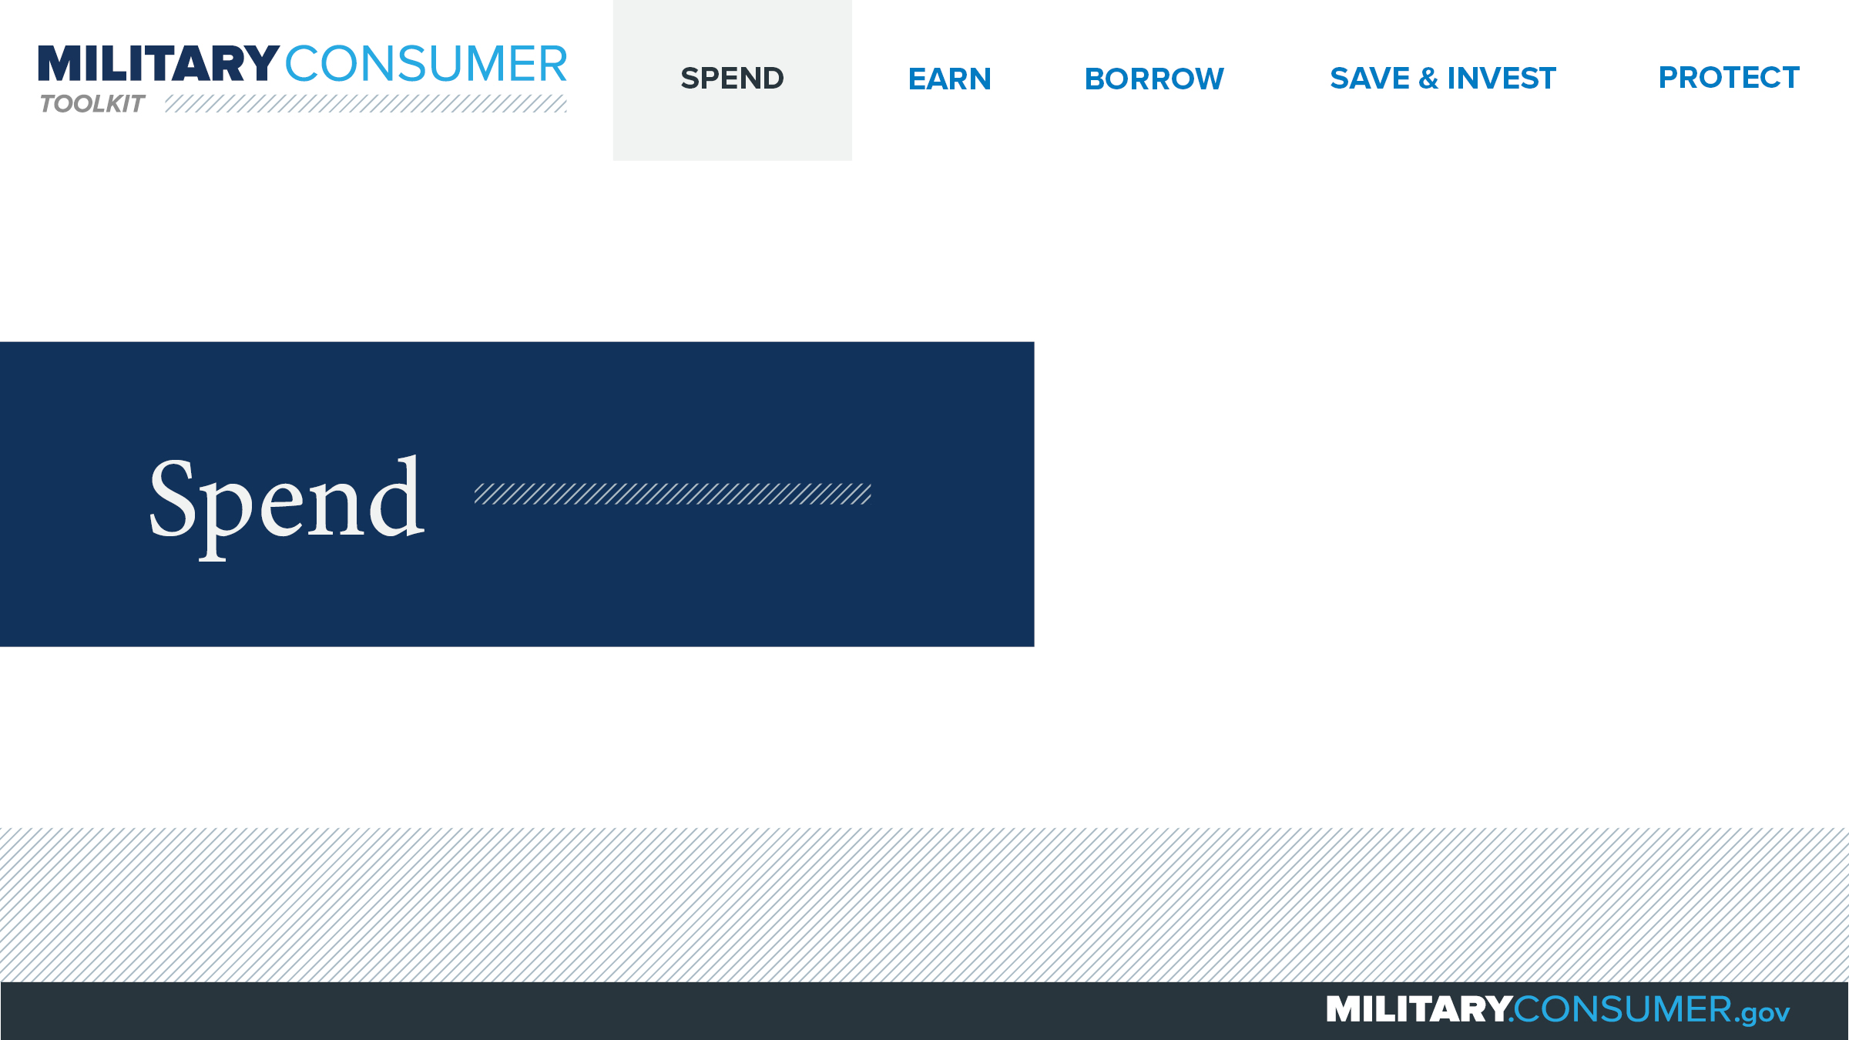
Notes:
Suggested Script:
Spending money is a fact of life. But it’s best to do this in a way that is carefully researched and planned out. When you know where your money is going, you have the power.
Today, we will learn about [PRESENTER: CUSTOMIZE TO SUIT THE TOPICS YOU WILL COVER] people who are available to help you plan your spending, how to create and manage a budget and how to shop smart for purchases ranging from small to large.

Slide 4
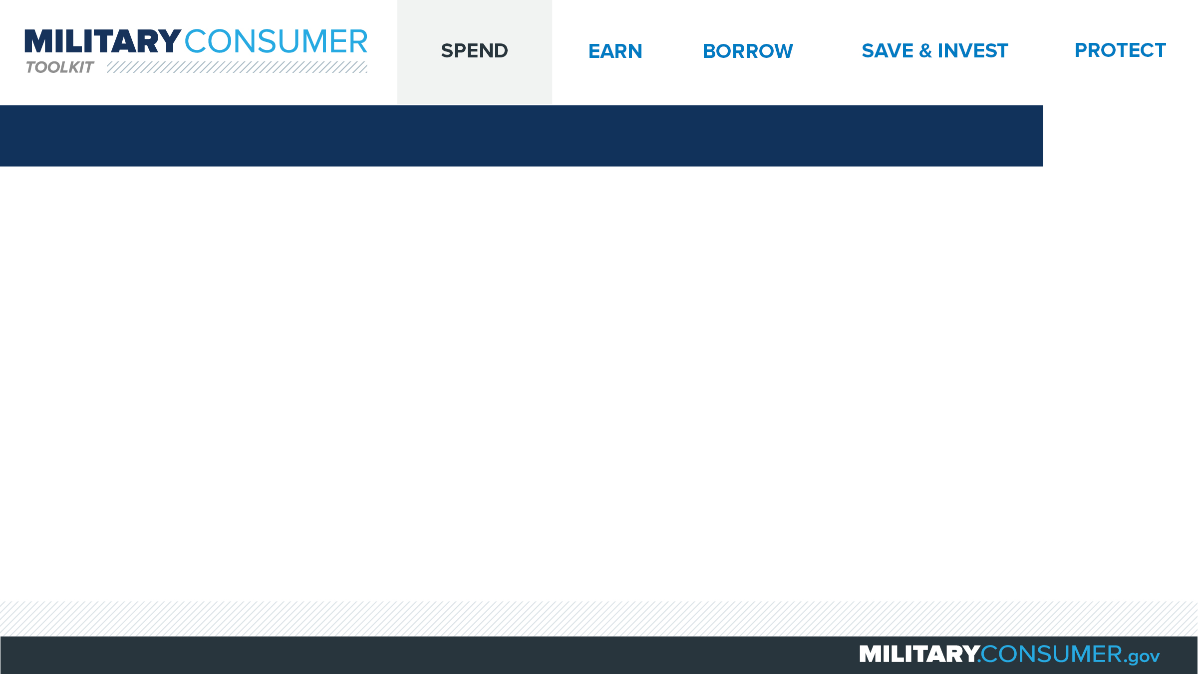
Personal Financial Managers (PFMs)
PFMs provide
  Confidential help
  Counseling
  Free classes
  Emergency financial help
  Free FICO credit score
To find a PFM
  Visit MilitaryInstallations.dod.mil and select
  “Personal Financial Management Services”
  Call Military OneSource at 1-800-342-9647
Notes:
Suggested Script:
(adapt script depending on whether speaker is a PFM, other counselor or someone else in the community.)
It’s important to know that you’re not alone in tackling financial topics. The Department of Defense has financial counselors, including Personal Financial Managers (or PFMs), who are available to help.
Can anyone here tell me what a PFM can help you with?
Working with PFMs is private and confidential. They can help you with things like one-on-one counseling; free classes and seminars on topics like money management, your credit, military savings programs and how to get out of debt; applying for emergency financial help; and getting your free FICO credit score through the FINRA Investor Education Foundation.
You can find a PFM by visiting the military installations website and choosing, “Personal Financial Management Services” or calling Military OneSource at 1-800-342-9647.

Slide 5
Legal Assistance Offices
Gives you free legal counsel
Servicemember Civil Relief Act
  Gives you reduced interest rates
  Can postpone negative actions
  Lets you terminate contracts or leases
  Protects your life insurance
To find legal assistance
  Visit MilitaryInstallations.dod.mil and select “Legal Services/JAG”
Notes:
Suggested Script:
Your installation’s legal assistance office can give you free help with a variety of legal issues. Specific services vary by installation.
If you’re an active duty servicemember, reservist or member of the National Guard on active duty, the legal assistance office can also help you understand your rights under the Servicemember Civil Relief Act (SCRA). These include getting lower interest rates on your mortgage, credit card, car and some student loans; postponing negative actions such as foreclosure, eviction and repossession; terminating your phone contract, auto or residential lease; and protecting against termination of your life insurance.
These protections start the day you begin active duty and end 30 to 90 days after the date you’re discharged.
To find your installation’s legal assistance office, visit the military installations website and choose, “Legal Services/JAG.”
Discussion Questions:
What are some reasons why you might visit your legal assistance office?

Slide 6
Budgeting
Your spend plan
Important when life is changing
Create your budget
  Add up total what you spend now
  Add up total the money you bring in now
  Compare the numbers
    Earn more than you spend? Start building an emergency fund
    Spend more than you earn? Look for ways to cut costs
Notes:
Suggested Script:
A budget is your spend plan – a roadmap for how you’re going to spend your money. With careful planning, and help from resources like your Personal Financial Manager (PFM), you can make sure you have money to pay your bills, have some fun and save for the future, which is particularly important as you think about making big changes like PCSing or transitioning to civilian life one day.
To create your budget:
Begin by writing down and adding up all of your current expenses, including bills that are the same every month (like car payments), bills that change every month (like credit card payments), bills you pay a few times a year (like car insurance) and your incidental costs, like food, transportation and entertainment.
Then add up all your sources of income, including your take-home pay and any other money you get, like child support.
Finally, take a look at and compare the totals.
Do you earn more than you spend? Great! You can start building an emergency fund or a transition fund to cover additional costs as things change in the future.
Do you spend more than you earn? Take a look at your expenses to find ways to cut costs. Your PFM can help you with this.

Slide 7
Money Management & Apps
Apps are offered by banks or credit unions
Maximize their use
  Understand tools
  Be secure
  Be aware of costs
  Know the limits of peer-to-peer payments
Notes:
Suggested Script:
How many of you have an app from your bank or credit union on your mobile phone?
As those of you who raised your hands know, most banks and credit unions offer apps that let you use your phone to track expenses, pay bills, transfer money and set alerts to fight fraud. There are several things to remember when using these apps:
First, before downloading, review the different tools that the app offers:
Alerts that let you know when bills are due or you reach a spending limit.
Tools to link your account with a partner or family member so that they can pay bills or make deposits to your account.
The ability to transfer money between accounts and to other people.
Tools that analyze your spending and keep tabs on your budget categories.
Research the app developer and check reviews from several trusted sources before downloading. Also, do not set any of your devices to remember your password. Enter it each time, or use fingerprint recognition or another security option that your bank or credit union offers, like two-factor authentication. That’s when you have to enter both a passcode and another piece of information to gain access. And, to avoid surprises, be cognizant that there might be data costs for using the app.
Finally, consider using peer-to-peer payment services as a convenient way to pay friends, but keep it secure. Use a PIN, monitor permissions, use a credit card as your payment source. Know how to shut off access if you lose your phone.
In general, be aware that your legal protections may vary, depending on how you make the payment.

Slide 8
Shopping Smart
Use military resources to save money
  Commissaries
  Exchanges
Search online for credible information
Use apps to get the best deals
Notes:
Suggested Script:
Being in the military means you have a few options for where to shop that will save you money. One of these is the commissary, where you and your family can buy groceries and household items for about 30% cheaper than civilians can. You can save even more at the commissary if you use coupons. Visit commissary.com to find the commissary closest to you.
The other great option is the military Exchange, where you can shop for goods and services (including haircuts, dry cleaning, gas and more) at discounted prices and tax-free. Exchanges can be both physical stores and online sites. If you are eligible to shop in one Exchange, you are eligible to shop in them all.
No matter where you shop, you should do your research first. Search online for information and credible opinions from trusted sources and compare reviews from a variety of websites.
You may also want to use a mobile app to make shopping easier. These apps can help check for deals or compare prices to ensure that you’re getting the best deal.
Discussion Question:
Have you used an app to get a great deal? What app did you use?
What’s the most incredible deal you’ve found in the commissary or Exchange?

Slide 9
Using Allotments
Payments deducted before you receive your paycheck
  Can be used to pay for things like life insurance or military loans
  Can not be used to pay for things like cars or furniture
Two types
  Discretionary
  Non-discretionary
PFM can help with
  Eligibility
  Fitting allotments into budget
  Planning for financial goals
Notes:
Suggested Script:
How many of you have heard of allotments?
Allotments are a way to pay for things directly from your paycheck – before you see the money. Servicemembers often use them to pay for things like life insurance or repaying military loans. They can not be used to pay for things like vehicles, furniture, electronics and jewelry.
There are two types of allotments:
You can set up to six discretionary allotments, which are payments to non-government organizations. For example, you could use a discretionary allotment to send money directly to your bank for your savings account.
You can set up to 15 non-discretionary allotments, which are payments to the government for things like savings bonds. Sometimes, the government might set these up for you to pay overdue taxes or loans from military relief agencies.
This may sound confusing. Fortunately, your Personal Financial Manager (PFM) can help you with allotments. First, your PFM will help you determine if you’re eligible – allotments are typically available to active duty service members, midshipmen, cadets, reservists on EAD and retirees. If you are eligible, your PFM will help you decide how many allotments make sense for your budget and how you can use them for short and long-term financial planning.

Slide 10
Buying a Phone
Do research and consider
your options
  Features
  Number of people on your plan
  Coverage maps
Make your purchase
  Shop around
  Ask about discounts
  Consider prepaid plans
  Read the contract
Notes:
Suggested Script:
Mobile phones can be essential for keeping servicemembers and their families in touch. When buying a phone, start by doing your research.
Think about what features you will need and consider how many people will use your plan, their calling, surfing and app usage habits and your budget.
Look at coverage maps and talk to current users to confirm that you’ll have voice and data signal where you need it.
Then, informed by your research, make your purchase.
Shop around online and in-store to compare prices and incentives, including military, veteran or other discounts that might be available to you.
Consider prepaid plans, which allow you to pay for the amount of talk, text and data that you need in advance. These may be cheaper than contract plans, but may also come with slower download speeds.
Thoroughly read and understand the contract, making sure that it includes everything that you’ve been promised and isn’t missing anything.

Slide 11
Buying a Phone
Know your rights
Ask about cancellation policies
Notes:
Suggested Script:
After you purchase your phone, if you are given orders to change your duty station or deploy, you can cancel your contract without penalty or fees, provided that:
Your wireless provider doesn’t provide service in the new location, or
Your mission doesn’t allow you to use the service, or
You’re deployed outside of the continental U.S. for more than 90 days.

Slide 12
Renting an Apartment or House
Plan ahead
  Know your budget
  Talk to others in the area
Considering a roommate
  Verify employment
  Run credit histories
  Talk about finances
When you find a place
  Understand the lease
  Do a walk-through
After you move in
  Buy renters insurance
  Pay your rent on time
  Get your landlord’s promises in writing
Notes:
Suggested Script:
Renting a home can be overwhelming, especially when you’re new to an area. Your first step is to plan ahead.
Begin by working with your Personal Financial Manager (PFM) to get a realistic sense of how far your money will go. Make sure that you’re factoring in the additional expenses that will come with the home, including commuting costs, utilities and security deposits.
Talk to people who live in your area or use online military family guides to identify neighborhoods where you would like to live.
If you’re considering a roommate, ask for verification of their employment and income, ask for a credit report (they can get one free at annualcreditreport.com) and check their references. If you move forward, be clear about who will pay what costs.
Suggested Script:
Once you’ve found a place that you are interested in:
Make sure you clearly understand everything in your lease. Pay particular attention to whether you can terminate it early if you have to PCS or have an extended temporary duty assignment.
On move-in day, conduct a walk through and document any existing damage.
After you move in:
Purchase renters insurance that will cover losses from theft or damage.
Always pay your rent on time to keep your home and build a credit record.
Keep communications with your landlord open and get promises in writing.

Slide 13
Buying a Home
Pros and cons
  Renting – you can move at a moment’s notice
  Buying – you owe mortgage payments until you sell, even if you move
If you buy
  Home = 2 to 2.5 times annual income
  Mortgage = 50-80 percent of home’s value at most
  Monthly housing costs = no more than 35 percent of income
Programs to help
  VA Home Loans program
  SCRA
Notes:
Suggested Script:
No matter where you are in your military career, owning a home can be a great investment. It also presents specific challenges to servicemembers and their families who may have to move at a moment’s notice.
Think through the pros and cons of renting vs. buying thoroughly. If you are renting and get new orders, you can move at a moment’s notice. Renting also may mean your up-front and monthly costs are lower, and you aren’t responsible for major maintenance. On the other hand, if you buy and are PCSed, your home could be left vacant and you on the hook for mortgage payments for however long it takes to sell. However, owning can provide tax advantages and offer you the opportunity to personalize your home.
If you decide to buy, here are several guidelines to keep in mind (although obviously the details of your situation may differ and affect your choices):
You may want to limit the cost of your home to 2 to 2.5 times your annual income.
For your mortgage, you should shoot for 50-80 percent of the value of your home at most, with monthly costs not exceeding 35 percent of your income.
Make sure that you explore programs that can help you with homeownership, including lower-interest VA Home Loans or lowered interest rates for existing homeowners and forgiveness of excess interest payments under the Servicemember Civil Relief Act (SCRA).

Slide 14
Buying a Car
Research
  Decide what you can afford
  Determine worth of your current car
  Decide how you will pay
  Do research before financing
Shop
  Choose the car and comparison shop
Buy
  Go to a dealer at the end of the month
  Focus on the “out the door” price
  Watch for add-ons or extra fees
  Lock in the total price first
  Remember – you can walk away
Notes:
Suggested Script:
How many of you have purchased a new car before?
Then you may know that doing research in advance is key to getting a good deal.
First, look at the total cost of the car, including fuel and insurance, as well as the down payment and monthly payments, to decide what you can afford.
Use a resource like Kelley Blue Book, Edmunds or the National Automobile Dealers Association’s Guides to determine how much your current car is worth.
Decide how you will pay for the car. If financing, do extensive research to understand your options.
Next, shop for the car. Decide what you want and research its features and price. Comparison shop for the car you’ve chosen by visiting websites and showrooms. And don’t forget to check the Exchange for special deals.
When it comes time to buy your car, try and go to the dealer at the end of the month, ideally at midweek. They’ll be more likely to make a deal then. As you negotiate, focus first on coming to agreement on the “out the door” price, keeping an eye out for unwanted add-ons or extra fees. Once that total price is locked in, you can discuss rebates, cash-back offers, trading in your old car and financing.
Remember, dealers expect you to negotiate. If at any time you feel pressured or decide you don’t like the deal, you can walk away and find another car and another deal.

Slide 15
Buying a Used Car
Find a car
  Decide what you can afford
  Decide how you will pay
  Do research before financing
  Shop around
Check it out
  Test-drive
  Maintenance record
  Warranty
  Inspection
  Car history
Buy and enjoy (or walk away)
Notes:
Suggested Script:
Used cars can be great deals, but it’s critical that you do your research before buying.
Begin by finding a car that you like. First, look at the total cost of the car, including fuel and insurance, as well as the down payment and monthly payments, to determine your price range. Then consider how you will pay and, if financing, research your options. Then, use a website like Kelley Blue Book, Edmunds or the National Automobile Dealers Association’s Guides to shop around for a car in your price range.
Once you’ve found a car that you like, check it out before you buy. Test drive the car in a variety of different conditions, including on the highway and in stop-and-go traffic. Ask for the car’s maintenance records and determine whether the car is still under warranty or a service contract. Hire a mechanic you trust to look over the car and give it a full inspection. And research the car’s history at vehiclehistory.gov, as well as any recalls at safercar.gov and whether it was flood damaged or declared as salvage at nicb.org.
Remember, you always can walk away. But if all looks good, move forward with buying your car and enjoy your new purchase.

Slide 16
Used Car Buyers Guide and Warranties
Save you money and headaches
Buyers Guide tells you if the car:
  Is sold “as-is”
  Is sold with an implied warranty
  Has a warranty and if it’s full or partial
  Is under the manufacturer’s warranty
  Has a service contract available
Compare and negotiate
Ask for and keep documents
Notes:
Suggested Script:
Understanding what kind of warranty a used car comes with can save you money and headaches later on.
All dealers are required to post Buyers Guides for the used cars they sell. This document will tell you about the warranty – if there is one – and what it covers, including:
If the car is sold “as-is,” which means you will pay for any and all repairs.
If the car is sold with an implied warranty, which means that the dealer will pay for serious problems that weren’t clear when you bought the car
If there is a warranty, whether it is full or partial, what it covers and who pays for how much of any repairs.
If the car is under the manufacturer’s warranty.
If a service contract is available for the car and whether it transfers.
Once you have a full sense of this information, use it to compare and negotiate warranty coverage until you feel comfortable.
After purchasing a car, ask for the car’s warranty documents from the dealer. Also, keep the final Buyers Guide that was posted in the vehicle, since it’s what determines the warranty you get.

Slide 17
Vehicle Financing
Decide what you can afford
Check with your bank or credit union first
See if the dealer can beat their rate
  Special rate
  Credit insurance
Compare loans based on APR
Choose a loan
Closely review paperwork
Notes:
Suggested Script:
It is very common to choose to finance large purchases like cars. When considering financing, begin by working with your Personal Financial Manager (PFM) to determine what you can afford, including your down payment, monthly payment, annual percentage rate (APR) and length of loan.
Then, check with your bank or credit union to see what Annual Percentage Rate (APR) they can offer to you. Many times, this will be the best deal available. Make sure by taking this rate to the dealership to see if they can beat it. When discussing financing with the dealer, find out:
If the dealer is offering any special rates, which may require a big down payment or high credit score.
If the dealer requires credit insurance, which would pay off your loan if you die or become disabled. If they do require credit insurance, talk to your PFM.
Compare your loan options based on the APR, looking for the lowest and most cost-effective option. Then, choose your loan and closely review the paperwork to ensure that it includes the required information, including the APR, the dollar amount of the total finance charge, the amount of money you’re borrowing, the total dollar amount of your finance charge plus the money you’re borrowing and the amount of payments and their number and due dates. Only sign a loan document that spells all this out, and never sign anything you don’t understand. After signing the contract, keep a copy.

Slide 18
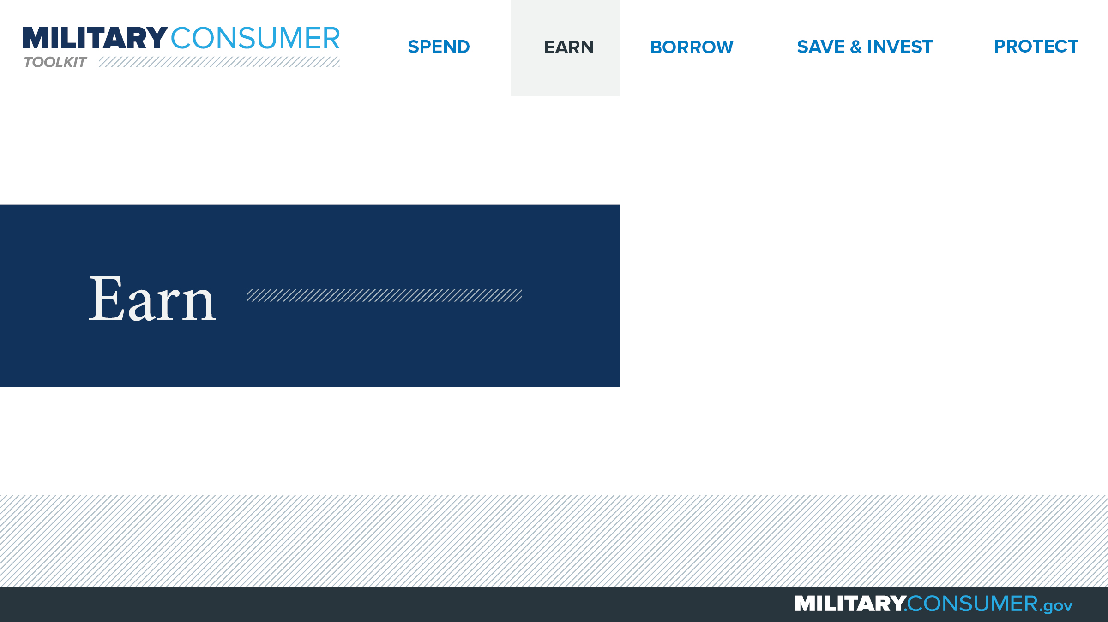
Notes:
Suggested Script:
Being in the military means that you have unique experience and benefits available to you that can help boost your earnings potential.
Today, we will learn about [PRESENTER: CUSTOMIZE TO SUIT THE TOPICS YOU WILL COVER] earning money – specifically, how to find and pay for schooling, as well as what to know about making money.

Slide 19
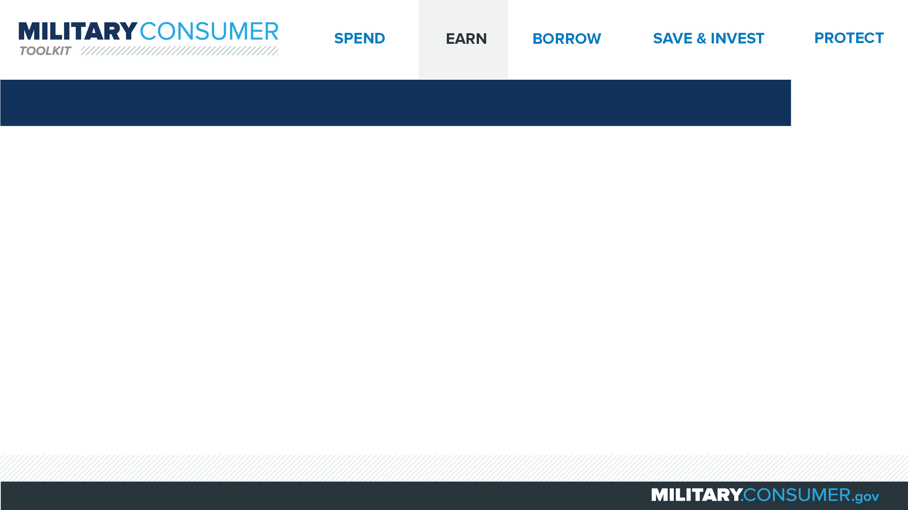
Choosing a College or Technical School
Research
  What type of education do you need?
  What kind of school offers those courses?
  Use GI Bill Comparison Tool - Vets.gov/gi-bill-comparison-tool
Experience the school
Get credit for your training
Review enrollment contract
Notes:
Suggested Script:
Education is key to many careers. Once you’ve decided what you want to do for a living, do your research to find out what schools offer the education you need.
Then, use the Department of Veterans Affairs’ GI Bill Comparison Tool to research schools and narrow down your list. Look at:
How many students complete programs at the schools.
How much the schools cost.
How many students default on their loans.
How much graduates from the school typically make 10 years after they enroll.
What type of accreditation the school has.
Use the College Navigator at http://nces.ed.gov/collegenavigator to find out whether the schools you are interested in are non-profit or for-profit. Some for-profit schools may stretch the truth to get you to enroll.
Then, check out the school for yourself. Sit in on some classes, and talk to student veterans and recent graduates. You might be able to get credit for your military training. Ask the school if they offer the College Level Examination Program and check with the American Council on Education to find out what credits your training can get you. Then, confirm this information with the school’s Registrar.
Finally, carefully read the school’s enrollment contract before you commit to make sure everything is correct.

Slide 20
Paying for Your Education
While in the service
  Tuition Assistance
  TA Decide - Dodmou.com/TADECIDE
  Voluntary Education Programs
  GI Bills
As you leave the service
  Transition Assistance Program
  State veterans’ benefits
  VA’s GI Bill Comparison Tool – Vets.gov/gi-bill-comparison-tool
  Scholarship info on Military OneSource
Notes:
Suggested Script:
There are numerous education benefits that can help you during your service or after you transition to civilian life. Understand what they are so you can put them to work for you.
While you are in the service, explore the following programs:
Your service’s Tuition Assistance program could pay for much or all of your costs.
DoD’s TA Decide program helps you compare schools to see if they accept your benefits.
Your service’s Voluntary Education contact can explain benefits, eligibility, funding and programs.
GI bill benefits – including post-9/11 GI Bill and Montgomery GI Bill – can be used while you are serving, but you may also want to save them for your transition or when you’re a veteran.
As you are planning to leave the service, check out the following:
The Transition Assistance Program prepares you and your family for pursing education, a job or business ownership as civilians.
State veterans’ affairs offices can explain what state benefits you are eligible for.
The VA’s GI Bill Comparison Tool tells you whether a school is approved for GI Bill benefits, how much they will cover and how much you’ll need to pay.
MilitaryOneSource can be a great place to find information about scholarships. Beware of companies that guarantee they can get you a scholarship in exchange for an up-front fee – most are scams.

Slide 21
Paying for Your Education
Student loan basics
  Supplement GI Bill benefits
  Lifetime cap
  Must repay even if you don’t finish
  Federal loans: better rates than private loans
  StudentAid.gov
Before you commit
  What’s the interest rate and the total cost?
  When repayment begin and how often will you pay?
  How long do you have to repay?
Notes:
Suggested Script:
Federal student loans can be used to supplement your GI Bill benefits and cover costs. Some important things to know about student loans include:
There’s a lifetime cap on the total amount of federal student loans you can take. Once you hit it, you can still get private loans, but those are usually more expensive.
For all loans, you must repay them even if you do not finish school.
Federal student loans typically offer better rates than private loans.
For more information about federal loans, grants and scholarships, visit www.studentaid.gov.
Before you commit to a student loan, make sure you understand what you’re getting in to. Start by talking to the school’s financial aid office to make sure you know the program’s total cost and how often you will need to pay. This could be by the course, semester or the full program.
Then, make sure you understand how much you’re borrowing and the interest rate, when repayment will begin and how much time you will have to repay the loan.
Discussion Question:
Which do you think is a better option, a federal student loan or a private one? Why?

Slide 22
Getting a High School Equivalency Diploma
Online diploma tests are scams
Legitimate tests
  Four options
  In-person, supervised
Find out more
  Check out your state’s department of education
  Community colleges
Other options
  Taking classes
  National External Diploma Program
Notes:
Suggested Script:
So, a high school diploma is required to join the service, but your spouses or family members may be interested in getting the equivalent of a diploma. So what are the things that they need to know?
First, any program that promises you can get a diploma by taking an online equivalency test or getting online work experience is a scam. There are only four legitimate high school equivalency tests. They include GED, HiSET, TASC and, in California, CHSPE. These tests are all in-person, proctored, closed-book tests, given on a specific date. Test-takers must show ID to prove they are the person who signed up to take the test.
Your state department of education can tell you what tests are accepted in your state, whether any online programs are approved and how to find a legitimate program. Your local community colleges can tell you which states are accepted in your state, how to register, what to study and whether they offer prep classes.
There are a few other options for earning your equivalency diploma. You can meet high school credit requirements by taking classes at a community college or university extension program. Alternately, some states recognize the National External Diploma Program, which is online and requires monthly in-person evaluations. And some states will accept credits from certain online courses and work skills or certifications.

Slide 23
Avoiding Job Hunting Scams
To find a job
  Military job fairs
  Feds Hire Vets – FedsHireVets.gov
  CareerOneStop – CareerOneStop.org
  USA Jobs – USAjobs.gov
  Installation education office
Using a job search service
  No legitimate company will charge you to guarantee a job
  Get promises in writing
  Insist on paperwork in advance
  Check out any jobs they find
Notes:
Suggested Script:
As you transition to civilian life, you may want to find a job. Some great resources for veterans to find jobs include:
Military job fairs, where you can meet employers who hire veterans.
The website Feds Hire Vets, which provides information about veterans preferences the federal hiring process and job listings.
The CareerOneStop website lists job openings, information in your state’s job bank and available training programs, including programs for veterans and others.
Details on federal and postal jobs are at usajobs.gov. Also check out your state’s Department of Labor.
Contact your installation education office about programs like Troops to Teachers, a program that helps transitioning servicemembers begin careers as teachers.
If you’re thinking about using a job search service, there are several things to keep in mind:
Remember – no job service can guarantee you a job, and no legitimate job service will promise you a job only if you’ll pay them. If they do, walk away.
Get all promises and details in writing, including what you will pay, what you will get, what happens if they don’t find you a job and what their refund policy is.
If they won’t give you paperwork to review in advance, walk away.
If the job service finds you a job, check it out. Does the company exist? Do they indeed have that open position? Are they working with the job service?

Slide 24
Being Your Own Boss in a Franchise
Do your homework
  How long is the agreement?
  Do your skills align?
  Will you achieve your goals?
Get advice
  Talk to a lawyer and accountant
Review your paperwork
  Should receive a Franchise Disclosure Document
  Review state laws
Notes:
Suggested Script:
Can anyone name a franchise?
Franchises can be a great way to work for yourself. They allow you to buy into a system that’s already developed. This can be great, but it can also limit your choices.
Before you guy into a franchise, do your homework:
Some franchise agreements last for 5-10 years. Make sure that you want to stay in one area, in one business for that long.
Consider if your skills, education and experience line up well with the business.
Think about whether the franchise will help you meet your financial goals.
Before you commit, talk to a lawyer to understand your legal obligations and an accountant to develop a business plan. Determine:
How much money you can afford to invest.
If you need financing and, if so, where you will get it.
If you need a specific minimum annual income and how you will get there.
Then, make sure the paperwork is in order.
At least 14 days before you sign a contract, the franchisor must give you a Franchise Disclosure Document (FDD), which lists key details about the business.
Your state may have disclosure laws to protect franchisees. Contact your state Attorney General’s office if the FDD doesn’t include this information.
If you don’t get the FDD, you may want to consider another opportunity.

Slide 25
Multilevel Marketing
Know the difference
  Multilevel marketing
  Pyramid scheme
Do your research
  Get details in writing
  Talk to distributors
  Search online
  Look for signs: Do distributors sell most of their product to other distributors? Do they make money from recruiting others?
Notes:
Suggested Script:
Multilevel marketing can seem like appealing ways to make money. It’s important to do your research to make sure you’re not signing up for a pyramid scheme instead.
Begin by understanding the difference:
In multilevel marketing, distributors sell products directly to other people and recruit new distributors. The money you make comes from sales, not recruiting.
In pyramid schemes, the money is based on the amount of people you recruit and sales to them. They are illegal because most people involved lose money.
Before you sign on, do your research:
Ask the person who is sponsoring you to provide all the details in writing – how you will be paid, any potential expenses (such as samples and marketing materials) and the refund policy on unused and unsold products.
Ask current and former distributors questions such as:
What are your annual sales, expenses and profit?
What percentage of the money you made came from recruiting others and selling them inventory to get started?
How long have you been in business? How long did it take to make money?
How many people have you recruited?
Search online to see the company’s reputation. Use the company’s name and words like, “review,” “complaint,” “pyramid,” or “scam.”
Look for common signs of a pyramid scheme. Do distributors sell most of their product to other distributors? Do they make money from recruiting others?

Slide 26

Notes:
Suggested Script:
Credit can be a great tool for helping you achieve your financial goals. But it has to be used responsibly, or else debt can become a big problem.
Today, we will learn about [PRESENTER: CUSTOMIZE TO SUIT THE TOPICS YOU WILL COVER] borrowing money – specifically, how to use credit and tips for dealing with debt.

Slide 27
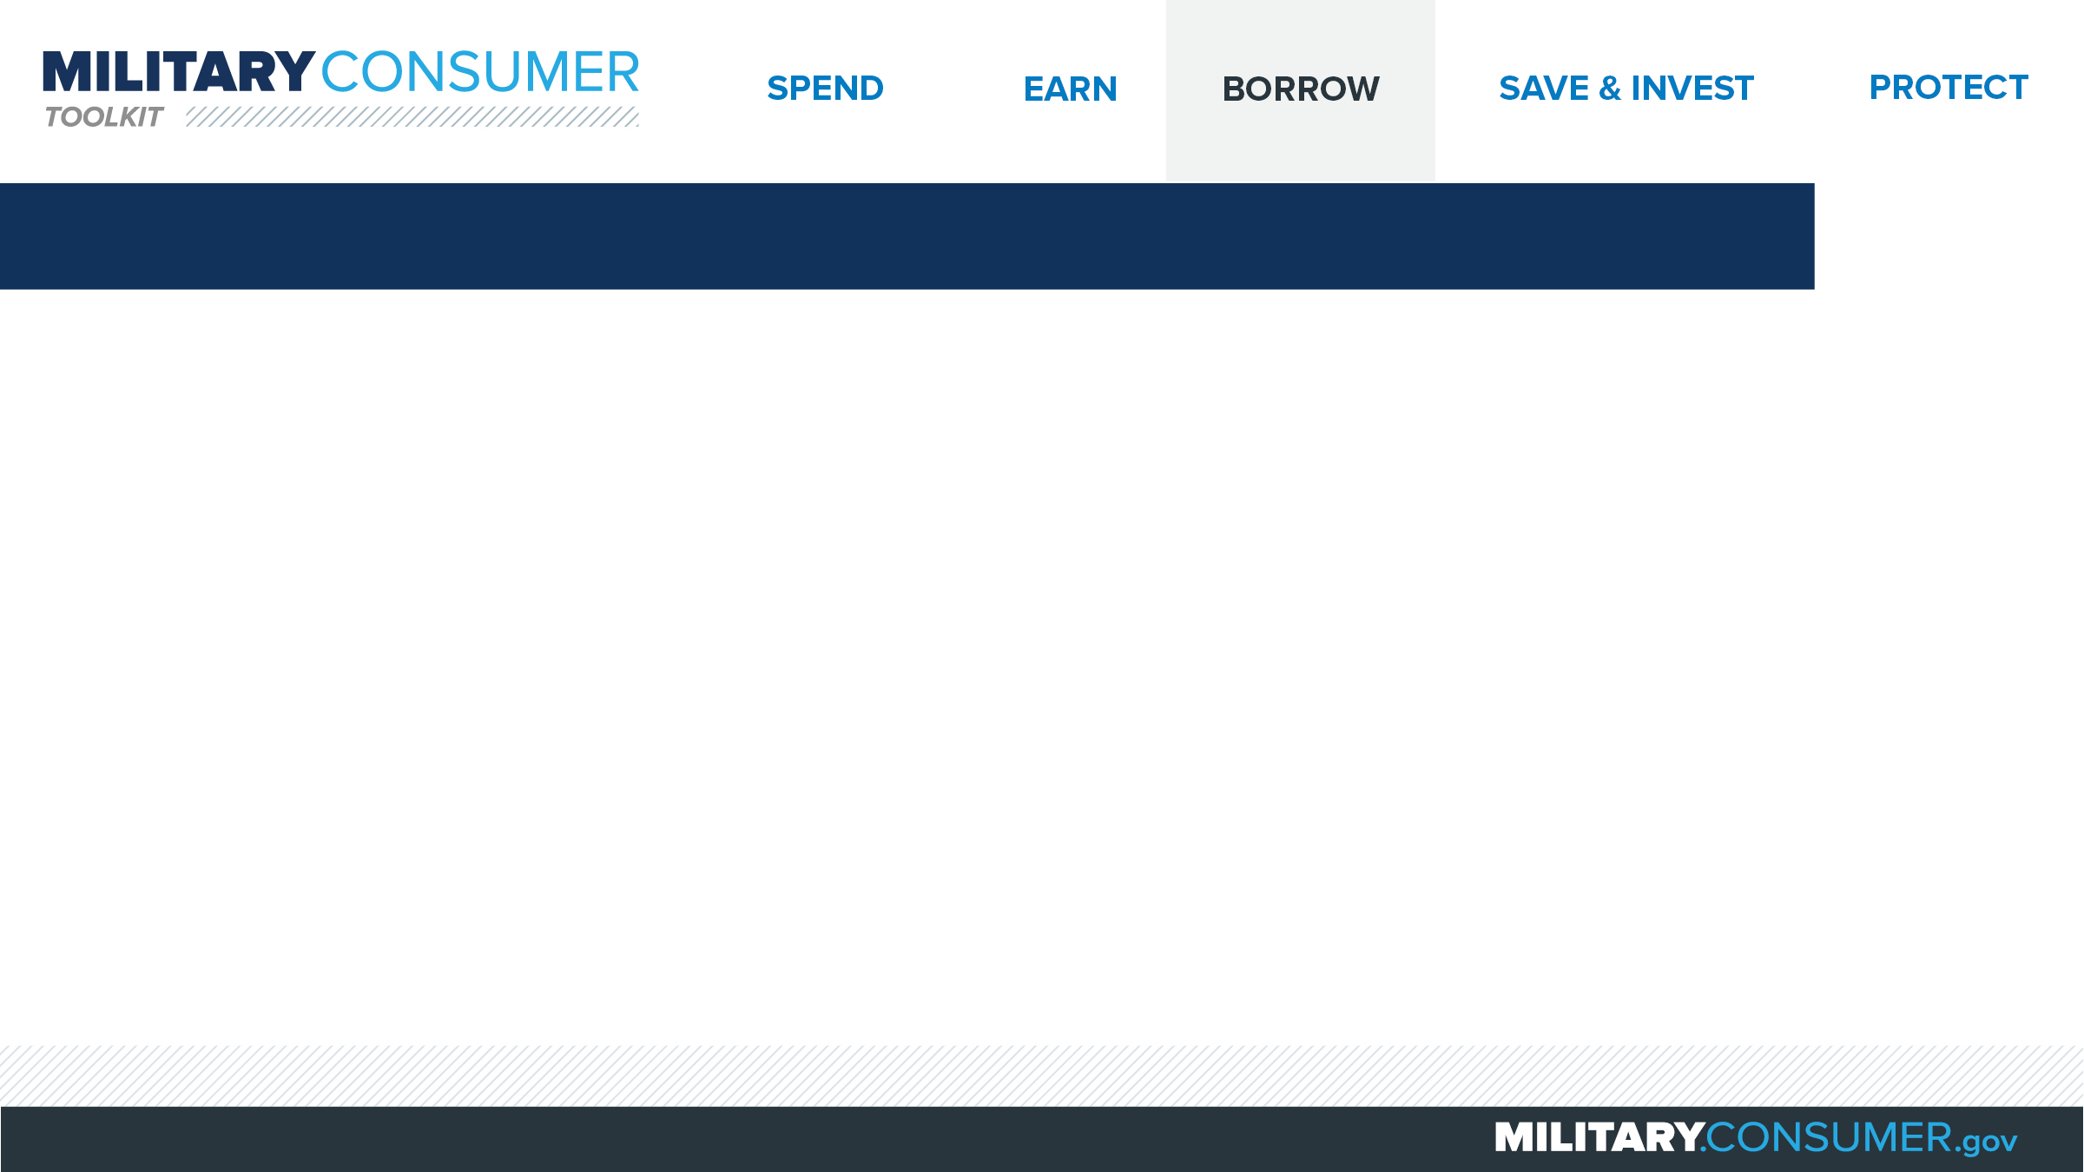
Being Smart About Using Credit Cards
Know the risks
  Carrying a balance
  Missing payments
Compare cards
  Annual and other fees
  APR
  Yearly interest
  Grace period
  Incentives
Monthly payments
Notes:
Suggested Script:
Anyone here have a credit card? Right, lots of us use credit.
Credit cards can be helpful tools, but buying now and paying later can add up. If you carry a balance on your credit card from month to month, you’ll pay interest on that balance every month. If you ever miss a payment, your interest rate will go up, so you’ll pay even more.
If you decide to get a credit card, compare at least three different ones. Look at:
The fees, including the annual fee (which is how much you pay to use the card each year), late fees and over-limit fees.
The annual percentage rate, or APR, which is the cost of credit expressed as a yearly rate.
How much interest you pay in a year on balances you carry over each month. The higher the APR, the more you’ll pay.
The grace period, which is the time between when you spend the money and when the card company charges you interest. Look for at least 25 days.
Other incentives, like airline miles, cash back or charitable donations.
Once you’ve chosen and have begun using your card, try to pay your whole bill every month. That will help you avoid interest charges and build a strong credit history. If you can’t pay in full, make at least the minimum payment by the due date.
Think carefully about how many credit cards you choose to have. Using them responsibly helps build your credit record, but a larger number can make it more tempting to spend more than you can afford or manage.

Slide 28
Prepaid Debit Cards
Pros
  Don’t need a bank account or strong credit
  Some may have overdraft features
Cons
  Doesn’t help with credit history
  High fees
Shop around
Compare to bank or credit union cards
Most prepaid cards don’t offer consumer protections
Notes:
Suggested Script:
Prepaid cards are cards you that you buy and add money to. You uses them until the money is gone, or longer if he card has overdraft protections. Then you can use the card to spend up to that amount.
Before using prepaid cards, consider the pros and cons:
The pros include that you don’t need a bank account or good credit to get and use a prepaid debit card. Some cards have overdraft features. But if your card doesn’t have these features, be careful of overspending; overdrafts can cause unexpected problems and additional fees.
The cons include that it doesn’t help you build your credit history, and the fees to use these cards can be high.
If you decide to use prepaid cards:
Shop around before you pick a card. Look at what the fees are, what happens if you lose the card or it’s stolen, and whether the money you put on the card earns interest.
Also, compare prepaid debit cards to the cards that you can get with your checking account at a bank or credit union. Look at all the details and decide which is the best option for you.
Also, know the protections and pitfalls before you pick a card. Some prepaid cards offer consumer protections but most do not.

Slide 29
Your Credit History
Tells businesses
  How much you owe
  How you pay your bills
Influences jobs, loans, security clearance and more
Know your story
  Get free credit report – AnnualCreditReport.com
  Review and fix any issues
  Your PFM can help you get your free credit score
Notes:
Suggested Script:
Your credit report tells businesses how much money you owe, and how you pay your bills. They then use that information to make decisions on important things like loans, security clearances, jobs, insurance, apartments, credit cards and mortgages. Whether you can get these things, and the rates you are offered, depend on whether you have good or bad credit.
To manage your credit, it’s important to know what your history looks like.
Begin by getting your credit report from AnnualCreditReport.com. After answering some questions, you’ll be able to choose from three credit reporting companies to get your report. Any one is fine, and you can get one free report from each company every year. Consider spreading them out so you get 1 report every four months.
Then, read the report and look for things that are incorrect. If you find something wrong, send a letter to the credit reporting company asking them to fix it. Send proof, like a copy of a bill that shows the right information. The companies are required to respond.
Another important piece of information is your FICO credit score, which is a number that creditors use to help determine whether to give you credit. Your Personal Financial Manager (PFM) can help you get this for free through the FINRA Investor Education Foundation.

Slide 30
Improving Your Credit
No credit history
  Pay bills on time
  Consider a secured credit card
Bad credit history
  Explore interest forgiveness
  Pay down cards
  Don’t get new cards
  Keep old accounts open
  Check periodically
  Get help
Notes:
Suggested Script:
People with no credit or bad credit can face challenges with borrowing money or getting security clearances, jobs, apartments and insurance. The good news, though, is that you can always improve your credit rating. Here’s how.
If you have no credit history, there are steps you can take to build a good one:
First, make sure that you pay your bills – especially mortgage, car and credit card payments – when they’re due.
Also, consider getting a secured credit card from your credit union, bank or another company. These cards allow you to deposit money up front, and then spend it down. Look for one with no or low fees, that lets you earn interest and that reports to the big credit reporting companies. Use the card a few times a month on the things you’d buy anyway, like groceries or gas.
If you have a bad credit history, work to improve it by:
Exploring interest forgiveness programs that may be available to you. While you’re on active duty, the law limits the interest rate on credit obligations incurred before service – including credit card debt – to 6 percent. Interest above that is forgiven.
Paying down your credit cards, beginning with the one with the highest rate.
Not ordering any new credit cards, as having a lot of new credit can be negative.
Keep your older credit card accounts open, even if you don’t use them.
Check your credit report – using annualcreditreport.com – periodically.
Get help from a Personal Financial Manager (PFM) or a certified credit counselor.

Slide 31
Improving Your Credit
While deployed
  Plan with your PFM
  Consider using automatic payments
  Delegate access
  Set up an active duty alert
  Research before using credit cards overseas
Notes:
Suggested Script:
There are several ways to make sure you keep your credit up while you’re deployed:
Meet with your PFM to create a plan before you deploy.
Consider setting up automatic bill payments that will help make sure that things are paid on time. But be sure you know how much you will pay and when. You can also use allotments for this.
Give someone you trust – like your spouse or parent – access to your accounts so they can keep an eye on things.
Set up an active duty alert to protect your accounts. This is something you add to your credit report to make businesses take extra steps before granting credit in your name.
If you’ll be using credit cards overseas, research before you go. Search online for “widely accepted credit card” and the name of the country you’re going to to find out whether businesses there are likely to accept your card.
Discussion Question:
How have you managed your finances when you’ve been deployed?
Was it challenging? Were there any tips or tools that helped you?

Slide 32
Need Money in a Hurry?
Payday and car title loans
  Charge extremely high rates
  Should be last resort
Better alternatives
  Bank or credit union loan
  Credit card
Get help
  Talk to PFM
  Call Military OneSource – 1-800-342-9647
Notes:
Suggested Script:
There may be times when you need to get money fast. And you may have seen advertisements from companies that make quick loans, like payday or car title lenders. While these can seem like a great option, these companies can be very expensive and charge extremely high interest rates – up to 36 percent for servicemembers. They should really be considered a last resort choice.
Think about whether you can get money from somewhere else. Consider a loan from your bank or credit union. Depending on the situation, even using a credit card may be better than a payday loan.
Also, know that there’s help for you if you’re facing financial trouble. Talk to your Personal Financial Manager (PFM) about your choices and options. You can also call DoD’s Military OneSource help line, 24 hours a day, seven days a week. The phone number is 1-800-342-9647, and they can help you with:
Helping you get more time to pay your bills.
Potentially getting you an advance on your paycheck.
Connecting you with a certified credit counselor who can help make a plan for managing your money.
Getting help from a military relief society.

Slide 33
Managing Debt
To repay debt
  Cut costs, apply savings to debt
  Contact lenders for help
  Consult a certified credit counselor
  Talk to your PFM
Evaluate a counselor, look at
  Services
  Costs
  Free benefits
  Credentials/licensing
Notes:
Suggested Script:
Debt mainly becomes a problem when you can’t pay it back. To keep debt collectors and credit issues at bay, act as soon as you identify a problem and take the following steps:
Make a monthly budget and stick to it. Look closely to identify ways to cut costs. Can you eat out less? Are there less expensive entertainment options? Apply any savings directly to your debt.
Contact your lenders to explain your situation and negotiate a reduced monthly payment. If you have a student loan from the government, contact the Department of Education at Studentaid.ed.gov or 1-800-4FED-AID (1-800-433-3243).
Contact your Personal Financial Manager (PFM) for assistance and a referral to a certified credit counselor. Be sure to interview a counselor before you sign up for services. Legitimate counselors won’t promise to fix all of your problems or charge you money before providing assistance. When you speak with them ask:
What will you do to help me?
How much do you charge?
Do you have free education and information?
Are you licensed to work here?
You can also get legitimate help from a credit union, local university or the U.S. Cooperative Extension Service.

Slide 34
Debt Collectors
If a debt collector contacts you:
  Take notes
  Ask for written notice
  Don’t accept harassment
  Talk to a certified credit counselor
If you get a summons
  Look at the details
  Work with PFM or legal services
  Show up in court
Notes:
Suggested Script:
When it comes to debt collection, remember that you have rights. The FTC gets more complaints about debt collectors than any other industry, and some debt collectors lie, threaten people, call the wrong person, tell others about the debt and generally break the rules. You do not have to accept unethical behavior.
If you get contacted by a debt collector:
Take notes on your conversation, including the date and time you talked, the contact’s name, address and phone number, and how they respond to your questions.
Ask for written notice of your debt. By law, debt collectors must provide this information in a “validation notice.” If you don’t think the debt is yours, follow instructions on the notice.
Hang up if a debt collector harasses you, curses or threatens you in any way. Report them to the FTC at http://www.ftc.gov/complaint.
If you receive a court summons related to bad debt, review it closely – it should include the name of the court, its clerk and a phone number to verify. Then, contact your Personal Financial Manager (PFM) or legal assistance office for support. If you don’t go to court, you could automatically lose.

Slide 35
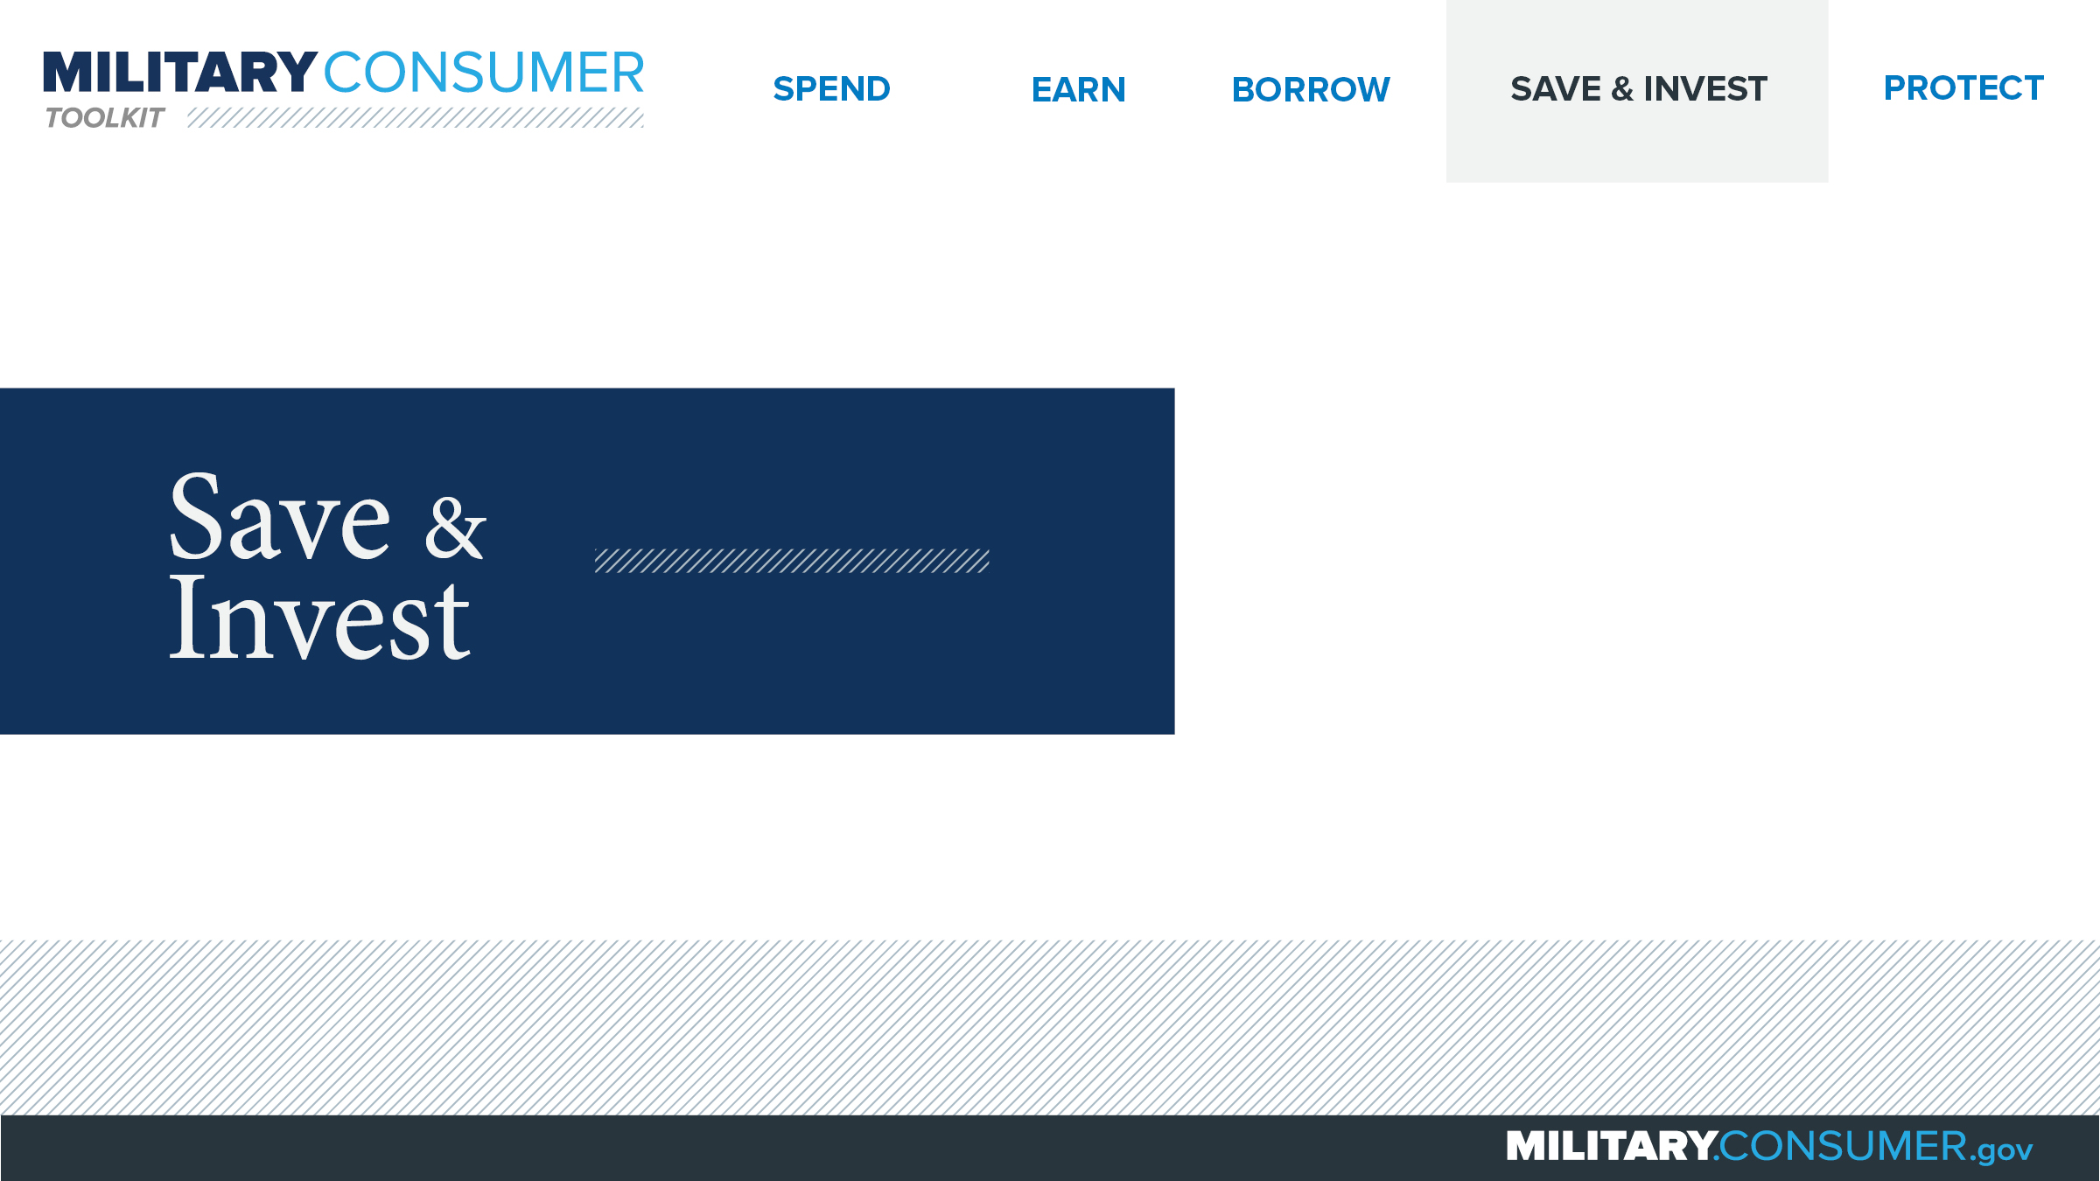
Notes:
Suggested Script:
One of the best ways to build a solid financial foundation is through sound savings and investment practices, which can make today’s paycheck work for you well into the future. Sounds great, right?
Saving and investing is not difficult if you take the right steps and avoid some common pitfalls. Today, we’ll help you do just that.

Slide 36
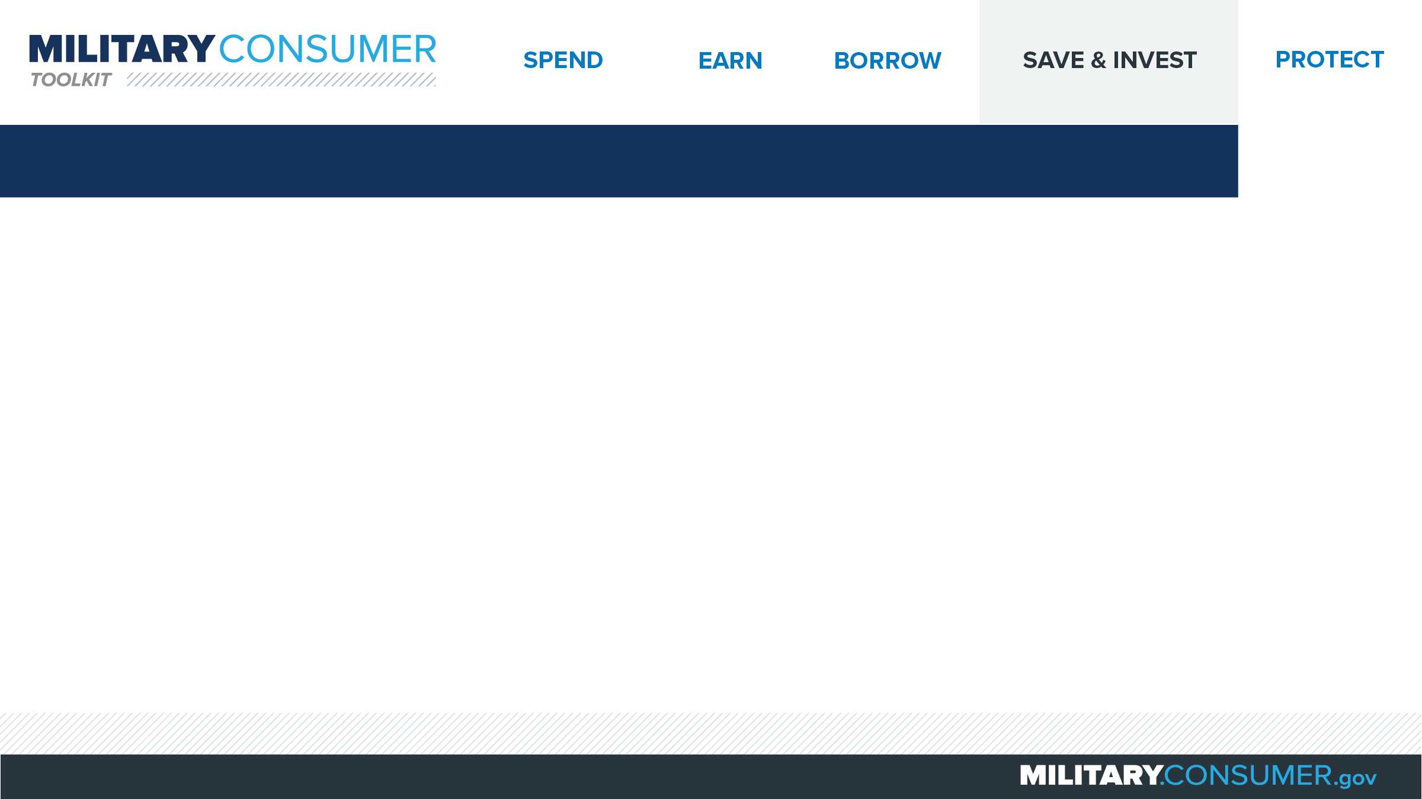
Saving
Build a foundation
  Set goal, timeline
  Use allotments
  Begin small and increase
  Start early
  Avoid high-interest loans, credit card balances
Save extra while deployed
  Savings Deposit Program
  Combat Zone Tax Exclusion Area
  Re-enlisting in a combat area
Notes:
Suggested Script:
Savings is the key to building a solid financial foundation and provides the peace of mind you need to prepare for the many changes that military life brings. To get started:
Set realistic savings goals and a timeline to save and invest long-term.
Use allotments to set aside savings from every paycheck.
Begin small and increase gradually. Start saving what you can now and gradually work up to saving 10 percentage of your income over time. Then, work toward saving another 10-20 percent of your income in an account that’s future-focused.
Start early for retirement planning. The younger you are when you begin saving toward retirement, the more time you give your money to grow. Begin contributing to the Thrift Savings Plan (TSP) immediately and take advantage of the government match (up to a certain percentage) and tax benefits.
Avoid high-interest loans and credit card balances. Pay off credit cards and account balances in full. Always pay debt with the highest interest rate first.
Also, boost savings with extra income during deployment and take advantage of specific military resources and benefits:
The Savings Deposit Program pays 10 percent interest on deposits up to $10,000.
In a Combat Zone Tax Exclusion Area? Some or all pay may be tax-free while you’re on duty.
Re-enlisting in a combat area? You may be entitled to a tax-free bonus.

Slide 37
Choices for Where to Save
Look for the best deal
  Fees, interest rates
  Convenience
  ATM access
  Mobile banking
  Minimum balance requirements
  Early direct deposit of active duty pay
  Military savings programs
Contribute to a TSP
Notes:
Suggested Script:
Where you save is important. Fortunately, today there are a variety of options availability to you – from national and community banks, credit unions, military banks and credit unions and online-only banks.
Choose a few of these and compare what they offer to find the best deal for you. Consider the following:
What are the fees, interest rates?
Is the bank convenient to you?
Is ATM access convenient? Are there fees associated with using non-bank ATMs?
Do they offer mobile banking? Is it convenient?
What are the minimum balance requirements?
Does the bank/credit union offer early direct deposit of active duty pay, which could allow you to access your pay sooner than regular military paydays on the 1st and 15th of the month.
Do you qualify for any special military savings programs that will help you boost your savings?
Last but not least, contribute to the Thrift Savings Plan (TSP) to help you save for retirement and take advantage of the government’s match (up to a certain percentage of your contributions), which equals free money.

Slide 38
Investing
Do your research
  Examine the opportunity
  Check qualifications
  Be clear on fees
Fraud red flags
  High rate of return, low risk
  Pressure to invest quickly
  “Get rich quick”
Notes:
Suggested Script:
Investing can be a smart way to make your money work for you, but there are no guarantees. Do your research to reduce your risk. Start by asking yourself:
What is the opportunity? For stock sales, this is easy information to come by as any company selling stock is required to provide investors with important information in a “prospectus.” Read it before you invest.
Is my investment advisor or firm qualified? There are a variety of resources available to you check qualifications based on the type of advisor.
What are the fees? The smallest difference can have a big impact on earnings.
Fraud is pervasive in the investment world. Avoid offers:
Promising a high rate of return and low risk. The potential for a high rate of return always comes with a high risk.
Pressuring you to invest quickly.
Advertising “get rich quick” or “make money fast.”
Watch out for scammers who work through groups you trust, like military or religious groups, or those who operate from a location near your installation.

Slide 39
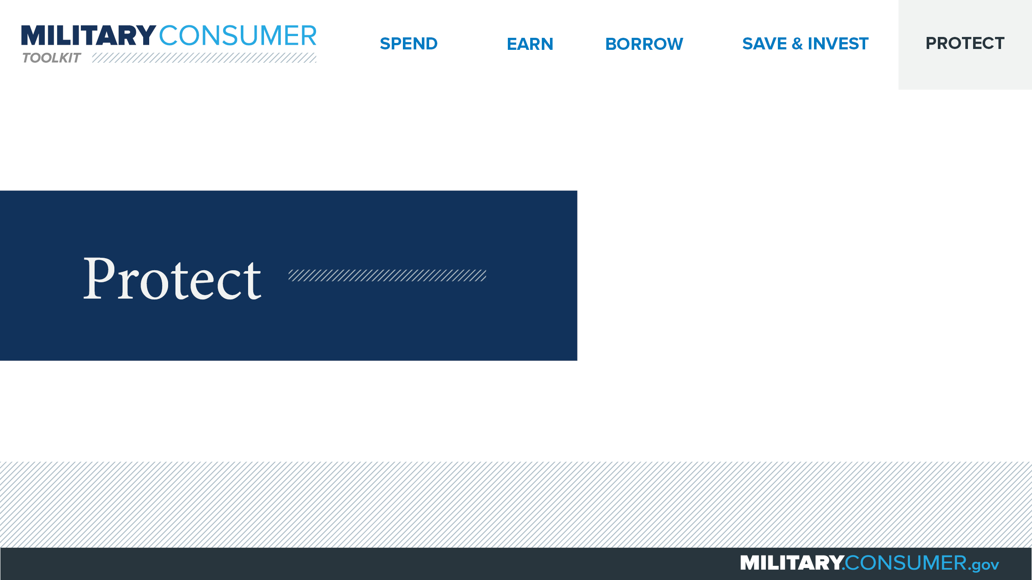
Notes:
Suggested Script:
With your financial situation in order, the last thing you want to do is have it be jeopardized by thieves and scammers.
Today, we’ll learn some actionable tips for keeping your finances safe, including [PRESENTER: CUSTOMIZE TO SUIT THE TOPICS YOU WILL COVER] how to safeguard your money, personal information, financial records and reputation.

Slide 40
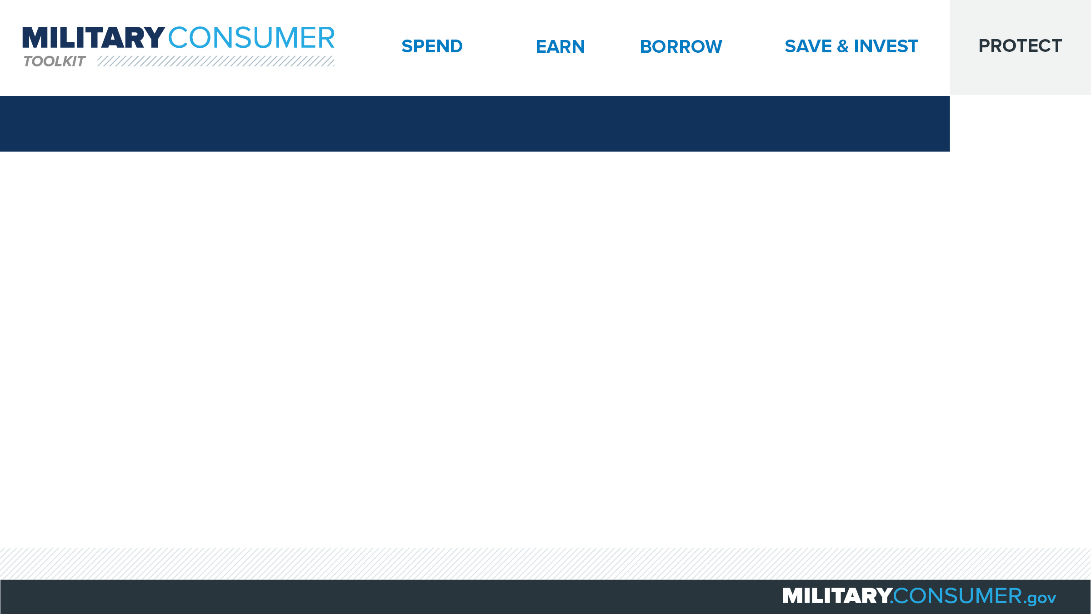
Ways to Avoid Scams
Beware of people or companies that:
  Ask for money, personal info
  Use recorded sales pitches
  Request payment via wire services, reloadable cards
  Ask you to deposit a check, wire money back
Stop and check it out
  Search online
  Talk to someone you trust
The FTC can help
  Free scam alerts
  Report scams
Notes:
Suggested Script:
Have you or someone you know ever fallen victim to a scam? It’s more common than you think. Although scam artists defraud millions of people ever year, avoiding fraud is within your control if you remember these helpful tips.
Beware of any individuals or companies that:
Call asking for money or personal information. Hang up immediately, and don’t rely on Caller ID to identify suspicious callers. It’s easily faked.
Use recorded sales pitches or “robocalls,” which are illegal.
Request payment via wire services or reloadable payment cards, neither of which offer a way to get your money back if it’s a scam.
Ask you to deposit a check and wire money back. If the deposited check turns out to be a fake, you will be expected to repay the bank.
Even though the caller may be pressuring you, stop and take the time to research any company or product before you buy.
Search for a company or product name online along with words like “review,” “complaint” or “scam” to uncover previous scam activity.
Also, talk to someone you trust to get their opinion.
The Federal Trade Commission is here to help.
Sign up for free scam alerts – http://www.ftc.gov/subscribe
Report scams – http://www.ftc.gov/complaint

Slide 41
Monitoring Your Credit Reports
Keep an eye on your credit
  Get your report – AnnualCreditReport.com
  Use active duty alerts
  Review your statements
  OPM data breach: check for eligibility
Notes:
Suggested Script:
Did you know that monitoring your credit is one of the easiest, most effective ways of keeping an eye on your financial situation, and it’s absolutely free?
Here are four ways to take advantage of the services available to you:
Access your free credit report at AnnualCreditReport.com every four months, requesting it from a different credit bureau each time to stagger them. Review this snapshot of your credit history and watch out for anything that is incorrect.
If you deploy, put an active duty alert on your credit report through one of the three credit bureaus to require creditors to verify your identity before extending credit in your name. They last for one year, but are renewable.
Review your bank and credit card statements and health plan explanation of benefits regularly for suspicious activity. See something unusual? Call to inquire.
Find out if you’re eligible for monitoring services as part of the OPM data breach. This was when, in 2015, hackers stole the personal data of millions of current and former federal employees, including active duty servicemembers and veterans.
If you received a notification letter and PIN code via mail, redeem your benefits for free up until December 31, 2018.
Not sure if you are eligible? Check online at OPM.gov/cybersecurity to determine whether you were impacted by the breach.
If you used the e-QIP system and used the same password for other accounts, change those passwords immediately.

Slide 42
Responding to Identity Theft
Minimize the impact
  Call the companies where you know fraud occurred.
  Visit IdentityTheft.gov
  Place fraud alert
  Get credit report
  Notify your commanding officer
Notes:
Suggested Script:
Identity theft can disrupt your life, wreck your finances and even lead to the loss of your security clearance. If you are the victim of identity theft, here are five helpful tips to help you act quickly and minimize the consequences.
First, call the companies where you know fraud occurred. Ask them to close or freeze those accounts because your identity was stolen. If you have online account access, change your logins, passwords and PINs.
Visit IdentityTheft.gov or call 1-877-438-4388 to report the fraud and create your personal recovery plan. Create an account so you can track your progress.
Contact one of the three credit bureaus to place a fraud alert. That credit bureau will contact the other two to alert them and request that they create alerts. You should receive a letter from each of the three credit bureaus confirming this has been completed on your behalf.
Experian: Experian.com/fraudalert, 1-888-397-3742
TransUnion: TransUnion.com/fraud, 1-800-680-7289
Equifax: Equifax.com/creditreportassistance, 1-888-766-0008
Get your credit report and review it carefully to determine whether there are other accounts or concerning items.
Notify your commanding officer to alert him/her to the fraud. You don’t want him or her to be caught off guard by calls trying to collect on debts that aren’t yours.

Slide 43
Seeing Through Imposter Scams
Imposter scams
  Appear to come from someone you know
  Pressure you to send money quickly
Common versions
  Distressed friend/family in need
  IRS call
  “Free” money from government
  Computer virus alert
  Online dating interest requesting money
Notes:
Suggested Script:
Imposters impersonate someone you trust and pressure you to send money quickly. These requests can come by text, phone or email. No matter what, never send money or give personal information in response to an unexpected request.
Some of the most common imposter scams include:
In one, a distressed friend or family member calls you in urgent need of money. If this happens, do your research to make sure the emergency is legitimate. Scammers can hack into loved one’s email addresses or use information available on social networking sites to convince you the ask is real.
In another, the IRS calls to tell you you have outstanding debt. Remember, the IRS will never contact you first by phone or ask for payments via prepaid debit cards, iTunes cards, wire transfers. They will also never ask for credit card payment by phone. When in doubt, visit IRS.gov or call 1-800-829-1040.
The government calls you to tell you you’re going to get money or a grant. But really, a legit government agency won’t ask you to pay a professing fee related to forms like the FAFSA or for a grant that you have already been awarded.
In this scam, you receive a call saying that your computer has a virus and the person calling can help. Don’t fall for it – never give control of your computer or your credit card to someone calling you unexpectedly.
In this final common scam, a person you’ve been talking to through an online dating site starts asking for money. Beware – scammers of all genders make fake dating profiles to build relationships and scam innocent people out of money.

Slide 44
Using Public Wi-Fi
Public Wi-Fi isn’t always secure
Encrypt, encrypt, encrypt
To minimize risks
  Choose secure networks/websites
  Use apps carefully
Notes:
Suggested Script:
How many of you know the difference between public and secure wireless networks?
Public Wi-Fi can usually be accessed without a password and is much less secure than a secure wireless network, which is typically password protected. There is no guarantee that information you transmit via public Wi-Fi is protected, which means that your information is at increased risk for access or misuse by unwanted parties. In contrast, all information you send on secure networks is protected.
In general, the key to security is encryption, a process of using software to scramble the information you send online, making it unreadable by unwanted parties. Both secure networks and encrypted websites, which contain the “https” web address prefix, use encryption.
Minimize your risk by only transmitting sensitive or financial information via secure wireless networks or encrypted websites. This includes the use of apps, which are only secure if used on a secure network or your phone’s data network (often referred to as 3G or 4G). If you are on public Wi-Fi, skip the app and try the mobile web site instead – if it has https in the web address, it’s safe to use.

Slide 45
Protecting Your Personal Information
Use strong passwords
Choose unique security questions
Use multi-factor authentication
Share SSN and account info judiciously
Beware of imposters
Lock up, shred sensitive documents
Info compromised? Visit IdentityTheft.gov
Notes:
Suggested Script:
You can only control what happens to your personal information as long as it’s in your possession. Here are seven simple tips for doing just that:
First, create strong passwords. The best passwords are at least 12 characters long and use a combination of uppercase and lowercase letters, numbers and symbols. Put non-lowercase letters in the middle and avoid common words or phrases. Have trouble remembering your passwords? Consider using a password manager.
Choose security questions only you can answer. Avoid using questions that can be answered through a simple search of public records (e.g., your zip code, birthplace, mother’s maiden name) or possess a limited number of responses that can be easily guessed through the process of elimination (e.g., the color of your first car).
Use multi-factor authentication, when available. More websites are requiring you to enter a combination of authentication factors before logging in. Factors could include a password plus a code texted to a mobile phone or a fingerprint.
Only share your Social Security and other account numbers (credit card, bank, utility) judiciously. Whenever someone asks you for your personal information, ask yourself “can I trust them?” And never share your personal information via social networking channels or public websites.
Beware of imposters. If you’re not sure if the person or company contacting you is legitimate, hang up or don’t reply. Do your own research by looking up the main customer service number and contacting them independently to verify.
Store documents containing sensitive financial information in a secured location. And if you no longer need it, shred it.
Visit IdentityTheft.gov for assistance the moment you suspect suspicious activity.

Slide 46
Securing Laptops, Phones and Other Devices
Protect access
  Never leave devices in car
  Carry laptops, tablets in nondescript cases
  On the go? Use hotel safes
  Employ “track your device” tools
  Backup files
Wipe devices
  Hard reset phones and remove SIM and SD cards
  Use wipe program on laptops
Notes:
Suggested Script:
Today, personal devices are just as valuable as what’s in your wallet. In fact, sometimes they are your wallet.
Fortunately, there are some simple tips you can put into action to keep your devices – and the valuable information they contain – safe.
First, never leave your devices in the car. It’s just too risky.
Carry laptops and tablets in backpacks, briefcases and other bags that aren’t as obvious as laptop bags.
While on the go, store laptops and tablets in hotel safes.
Track your device locations using available software programs so that they are easy to locate if lost or stolen.
Back up your files on removable discs, external hard drives or online storage services to guarantee you always have access to your important information in the event of theft or loss.
Before recycling or donating, make sure devices are wiped.
For phones or tablets, look up how to hard reset or wipe the device in your owner’s manual or on your mobile provider or device manufacturer’s websites. Remove or erase SIM and external SD cards, and remove any apps and the data associated with them.
Before recycling or donating your laptop, save any files you want to keep to a new computer or an external drive. Then use a wipe program to erase the hard drive.

Slide 47


