Slide 1
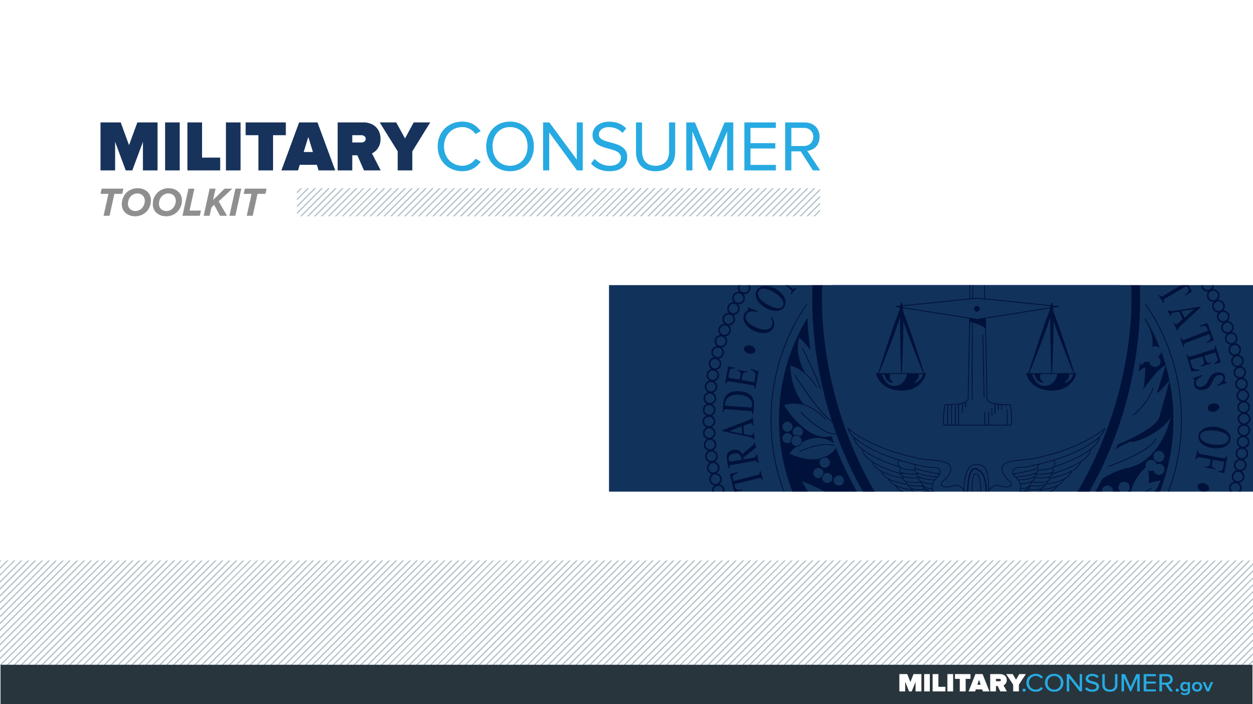

Slide 2
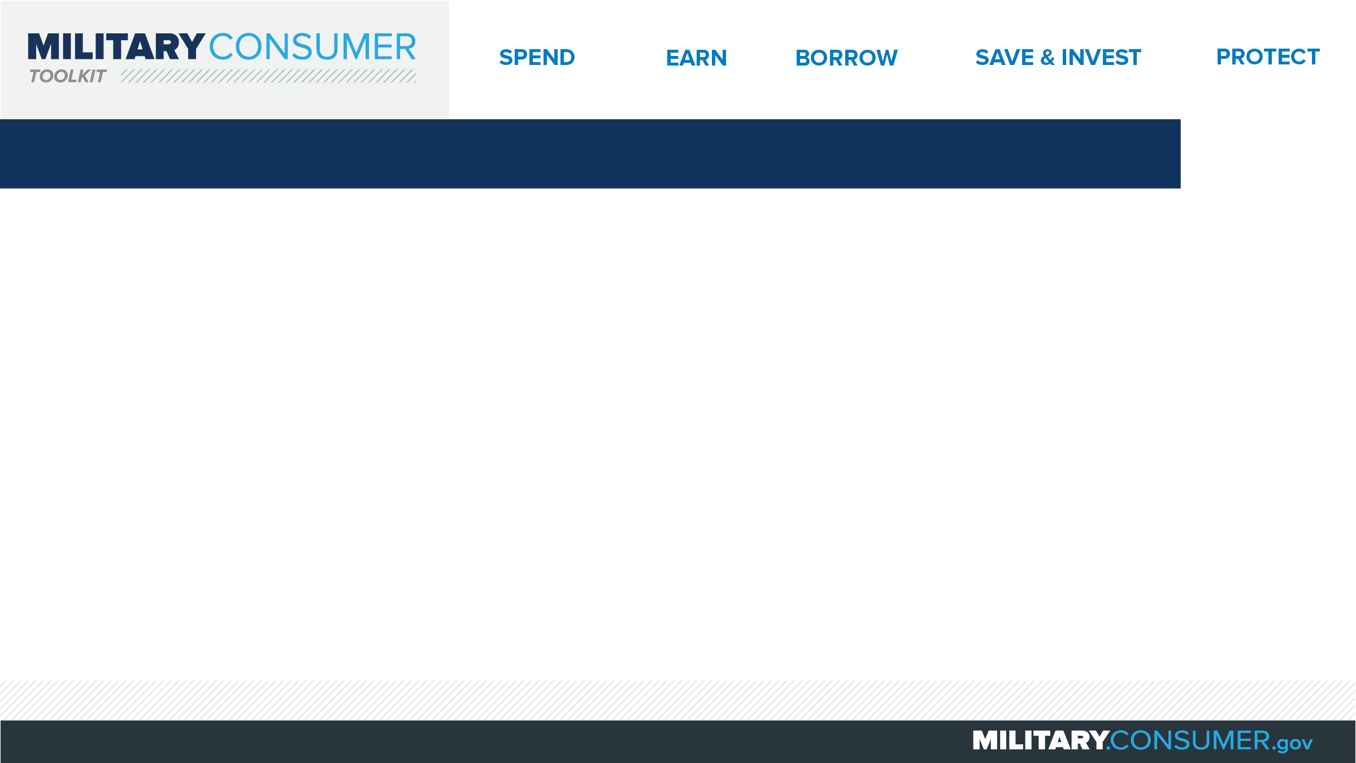
Why This Matters
Studies show that, on average, military families have higher amounts of debt and fewer assets than civilians
Challenges of military life can affect servicemembers’ finances:
  Frequent transition and changes
  Many servicemembers have little financial experience
  Decisions have long-term effects
Getting the know-how is key to making smart financial decisions
Notes:
[Presenter: Use this slide to set up the rest of your presentation, following it with slides that focus on the specific topics you want to cover.]
Suggested Script:
Today I’d like to talk about financial readiness – why it’s important and what you need to know to achieve it.
According to the National Foundation for Credit Counseling, active members of the military, veterans and their families have higher amounts of credit card debt and fewer assets than civilians. This means that military families are less equipped than their civilian counterparts to have the money they need for a secure future.
This is caused by many factors. As you know, military life is full of events and transitions, and each of these events brings the need to make important financial decisions. Unfortunately, many servicemembers – especially those without much financial experience – lack the information they need to make the right choices. This is particularly scary because many of these decisions can have long-term effects on a servicemember’s security clearance, mission readiness and family life.
Understanding your finances is your first line of defense. That’s why I’m here today – to help provide you with practical tips and information that will help you feel prepared to make these critical decisions.

Slide 3
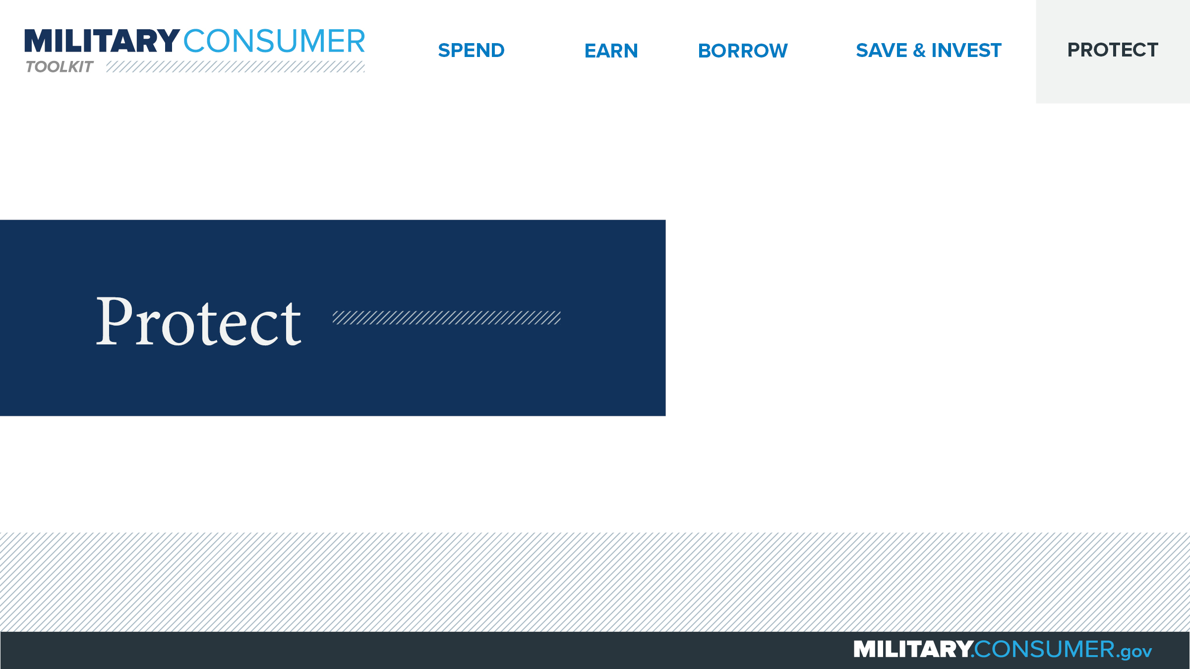
Notes:
Suggested Script:
With your financial situation in order, the last thing you want to do is have it be jeopardized by thieves and scammers.
Today, we’ll learn some actionable tips for keeping your finances safe, including [PRESENTER: CUSTOMIZE TO SUIT THE TOPICS YOU WILL COVER] how to safeguard your money, personal information, financial records and reputation.

Slide 4
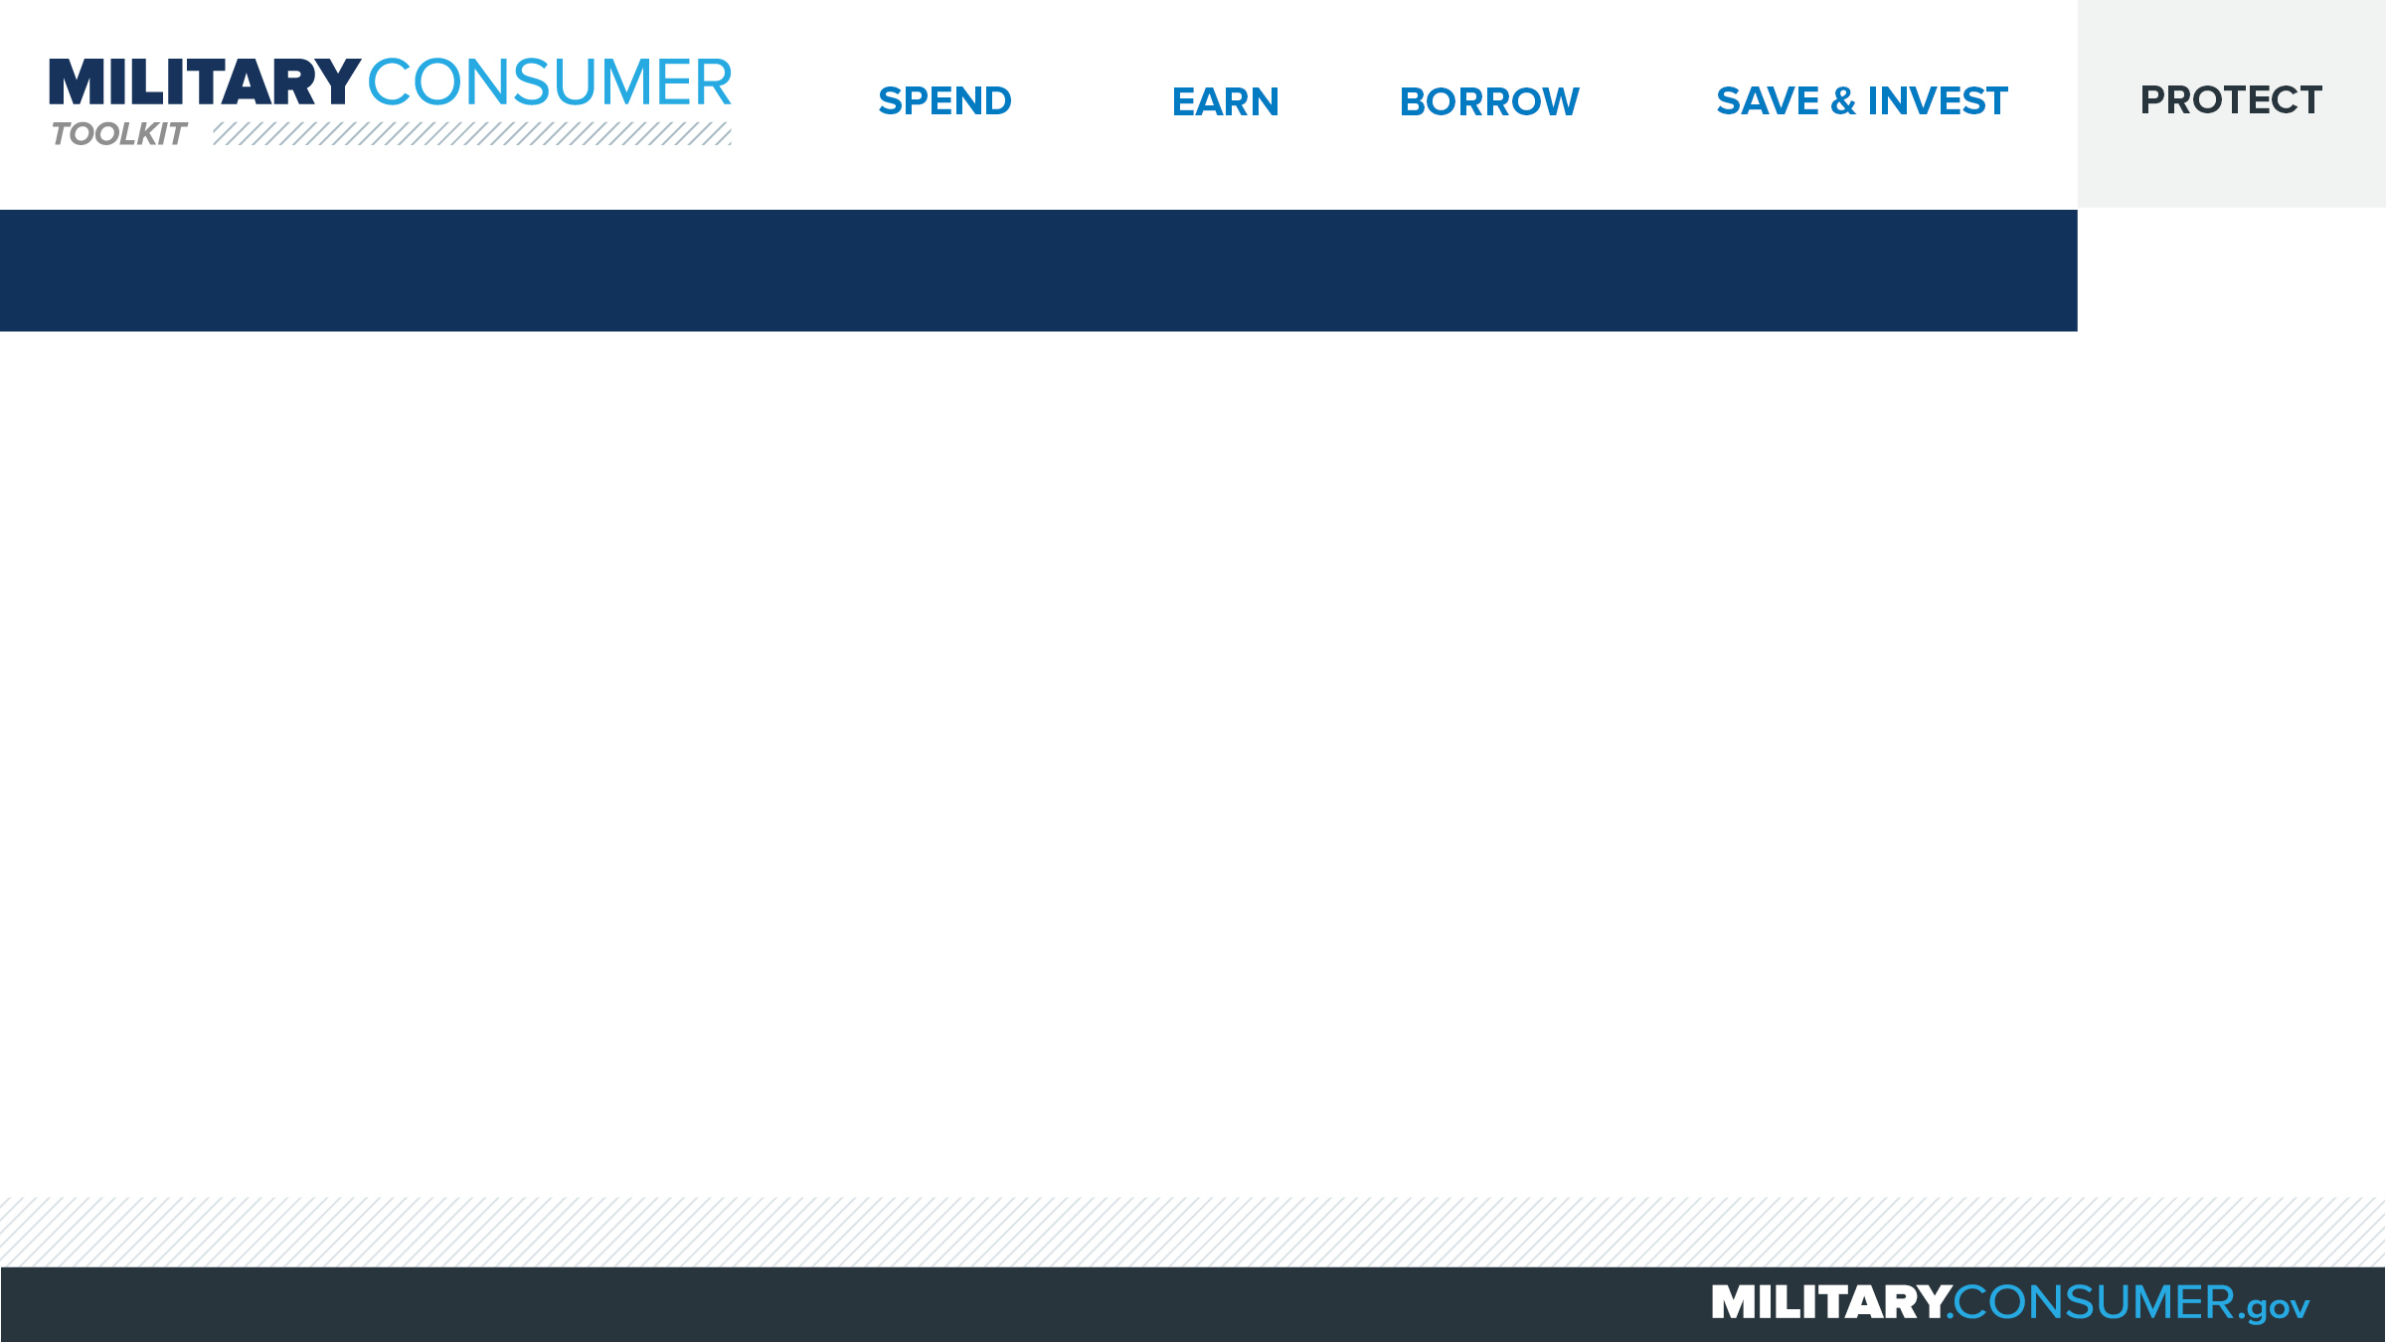
Using Public Wi-Fi
Public Wi-Fi isn’t always secure
Encrypt, encrypt, encrypt
To minimize risks
  Choose secure networks/websites
  Use apps carefully
Notes:
Suggested Script:
How many of you know the difference between public and secure wireless networks?
Public Wi-Fi can usually be accessed without a password and is much less secure than a secure wireless network, which is typically password protected. There is no guarantee that information you transmit via public Wi-Fi is protected, which means that your information is at increased risk for access or misuse by unwanted parties. In contrast, all information you send on secure networks is protected.
In general, the key to security is encryption, a process of using software to scramble the information you send online, making it unreadable by unwanted parties. Both secure networks and encrypted websites, which contain the “https” web address prefix, use encryption.
Minimize your risk by only transmitting sensitive or financial information via secure wireless networks or encrypted websites. This includes the use of apps, which are only secure if used on a secure network or your phone’s data network (often referred to as 3G or 4G). If you are on public Wi-Fi, skip the app and try the mobile web site instead – if it has https in the web address, it’s safe to use.

Slide 5
