Slide 1
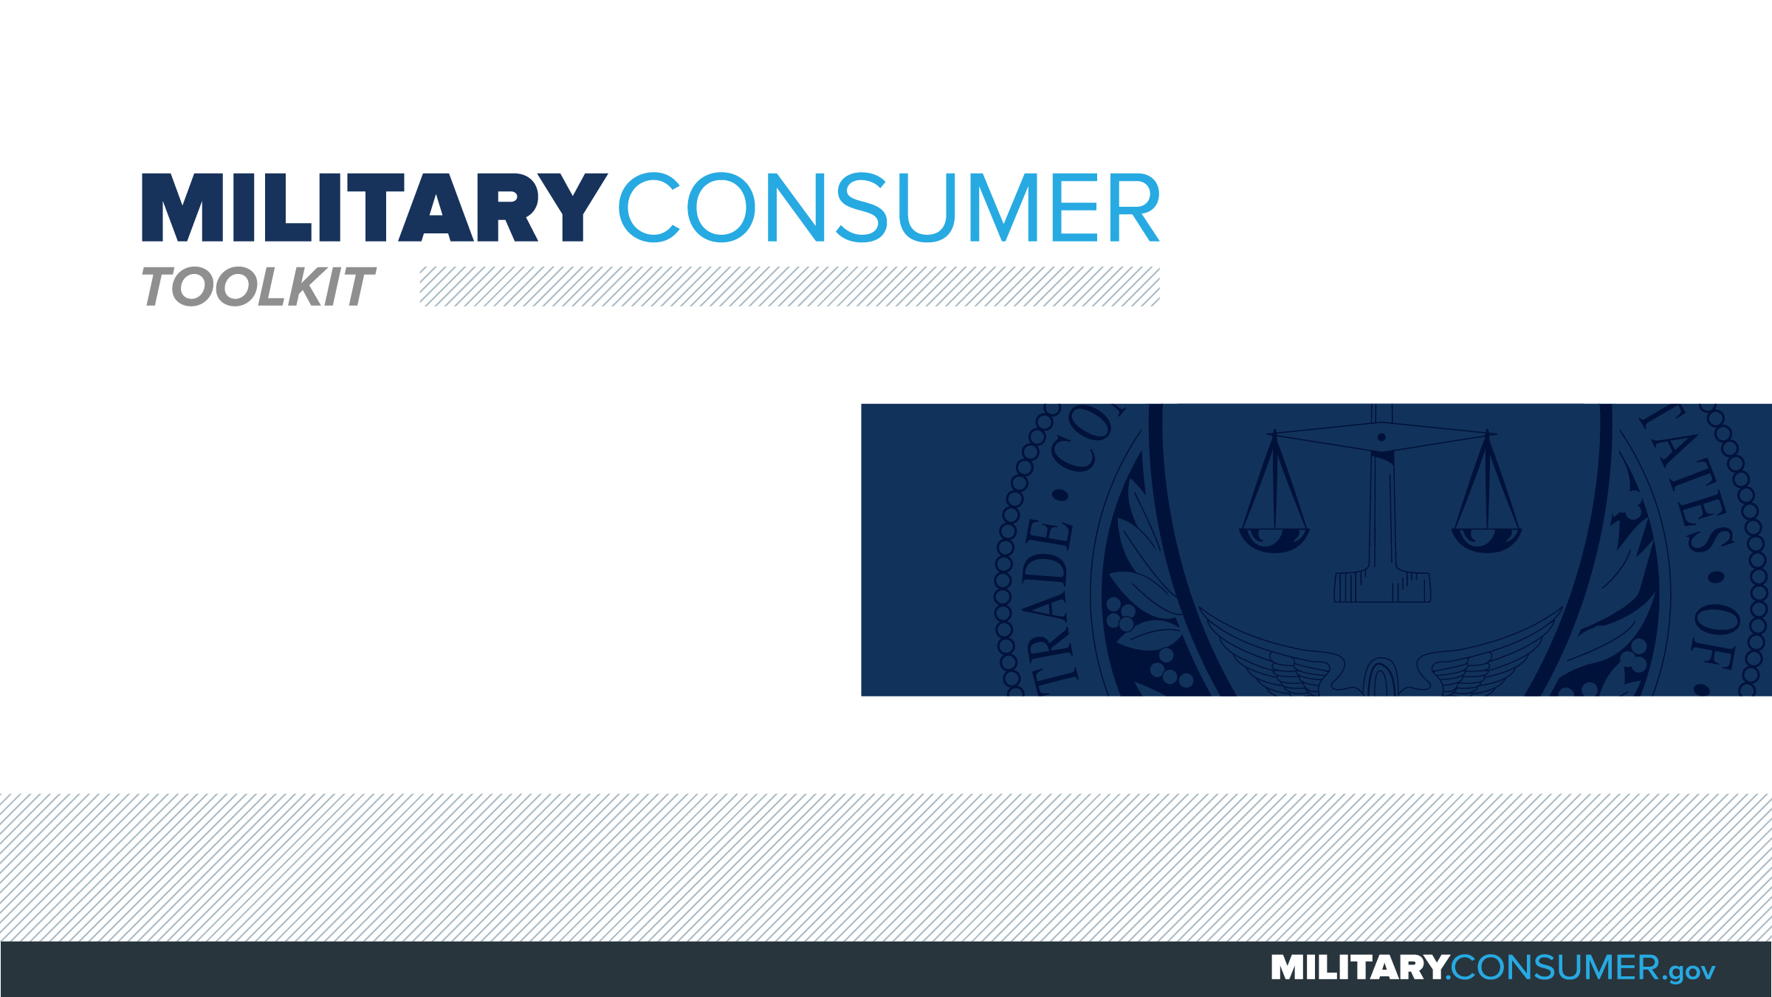

Slide 2
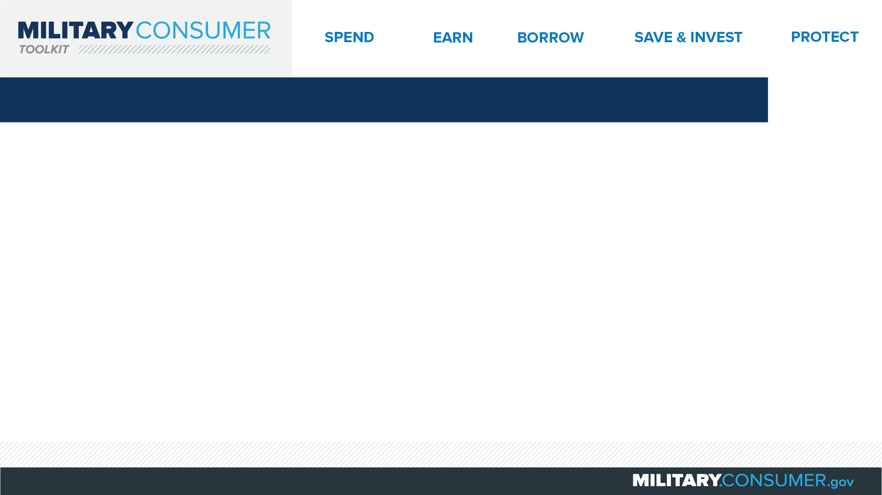
Why This Matters
Studies show that, on average, military families have higher amounts of debt and fewer assets than civilians
Challenges of military life can affect servicemembers’ finances:
  Frequent transition and changes
  Many servicemembers have little financial experience
  Decisions have long-term effects
Getting the know-how is key to making smart financial decisions
Notes:
[Presenter: Use this slide to set up the rest of your presentation, following it with slides that focus on the specific topics you want to cover.]
Suggested Script:
Today I’d like to talk about financial readiness – why it’s important and what you need to know to achieve it.
According to the National Foundation for Credit Counseling, active members of the military, veterans and their families have higher amounts of credit card debt and fewer assets than civilians. This means that military families are less equipped than their civilian counterparts to have the money they need for a secure future.
This is caused by many factors. As you know, military life is full of events and transitions, and each of these events brings the need to make important financial decisions. Unfortunately, many servicemembers – especially those without much financial experience – lack the information they need to make the right choices. This is particularly scary because many of these decisions can have long-term effects on a servicemember’s security clearance, mission readiness and family life.
Understanding your finances is your first line of defense. That’s why I’m here today – to help provide you with practical tips and information that will help you feel prepared to make these critical decisions.

Slide 3
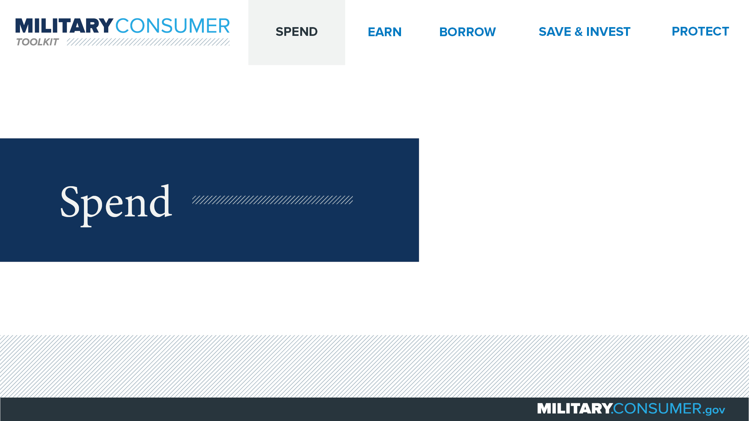
Notes:
Suggested Script:
Spending money is a fact of life. But it’s best to do this in a way that is carefully researched and planned out. When you know where your money is going, you have the power.
Today, we will learn about [PRESENTER: CUSTOMIZE TO SUIT THE TOPICS YOU WILL COVER] people who are available to help you plan your spending, how to create and manage a budget and how to shop smart for purchases ranging from small to large.

Slide 4
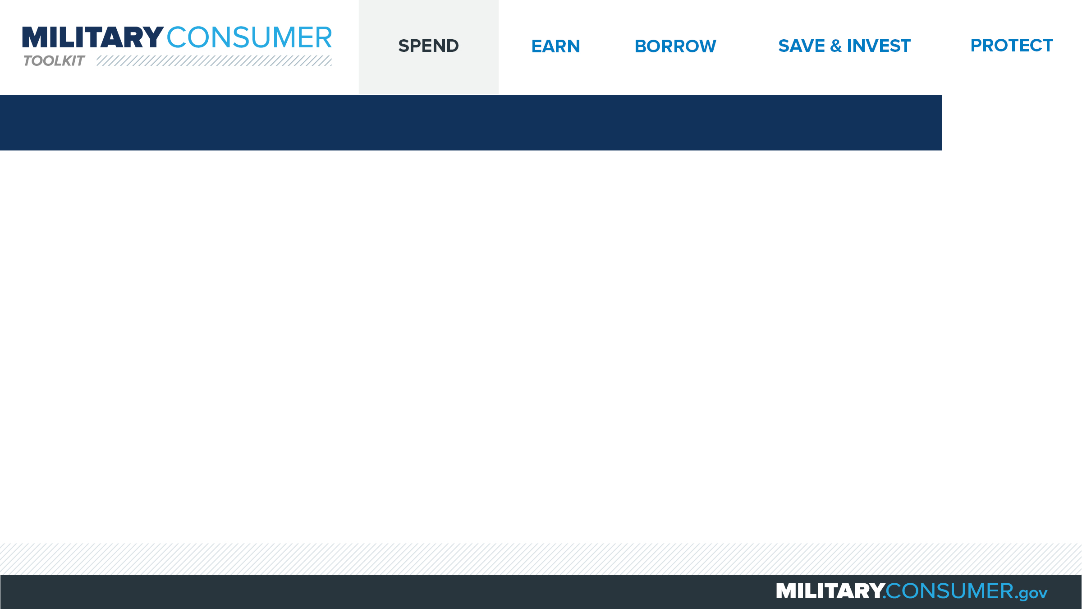
Budgeting
Your spend plan
Important when life is changing
Create your budget
  Add up total what you spend now
  Add up total the money you bring in now
  Compare the numbers
    Earn more than you spend? Start building an emergency fund
    Spend more than you earn? Look for ways to cut costs
Notes:
Suggested Script:
A budget is your spend plan – a roadmap for how you’re going to spend your money. With careful planning, and help from resources like your Personal Financial Manager (PFM), you can make sure you have money to pay your bills, have some fun and save for the future, which is particularly important as you think about making big changes like PCSing or transitioning to civilian life one day.
To create your budget:
Begin by writing down and adding up all of your current expenses, including bills that are the same every month (like car payments), bills that change every month (like credit card payments), bills you pay a few times a year (like car insurance) and your incidental costs, like food, transportation and entertainment.
Then add up all your sources of income, including your take-home pay and any other money you get, like child support.
Finally, take a look at and compare the totals.
Do you earn more than you spend? Great! You can start building an emergency fund or a transition fund to cover additional costs as things change in the future.
Do you spend more than you earn? Take a look at your expenses to find ways to cut costs. Your PFM can help you with this.

Slide 5


