Slide 1
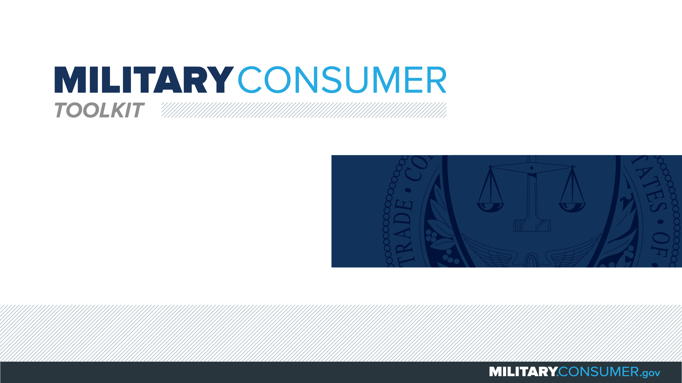

Slide 2
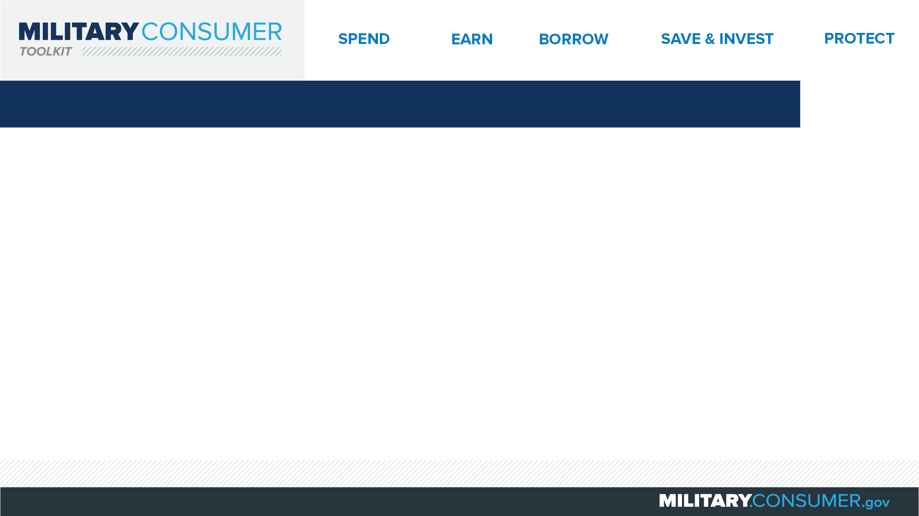
Why This Matters
Studies show that, on average, military families have higher amounts of debt and fewer assets than civilians
Challenges of military life can affect servicemembers’ finances:
  Frequent transition and changes
  Many servicemembers have little financial experience
  Decisions have long-term effects
Getting the know-how is key to making smart financial decisions
Notes:
[Presenter: Use this slide to set up the rest of your presentation, following it with slides that focus on the specific topics you want to cover.]
Suggested Script:
Today I’d like to talk about financial readiness – why it’s important and what you need to know to achieve it.
According to the National Foundation for Credit Counseling, active members of the military, veterans and their families have higher amounts of credit card debt and fewer assets than civilians. This means that military families are less equipped than their civilian counterparts to have the money they need for a secure future.
This is caused by many factors. As you know, military life is full of events and transitions, and each of these events brings the need to make important financial decisions. Unfortunately, many servicemembers – especially those without much financial experience – lack the information they need to make the right choices. This is particularly scary because many of these decisions can have long-term effects on a servicemember’s security clearance, mission readiness and family life.
Understanding your finances is your first line of defense. That’s why I’m here today – to help provide you with practical tips and information that will help you feel prepared to make these critical decisions.

Slide 3
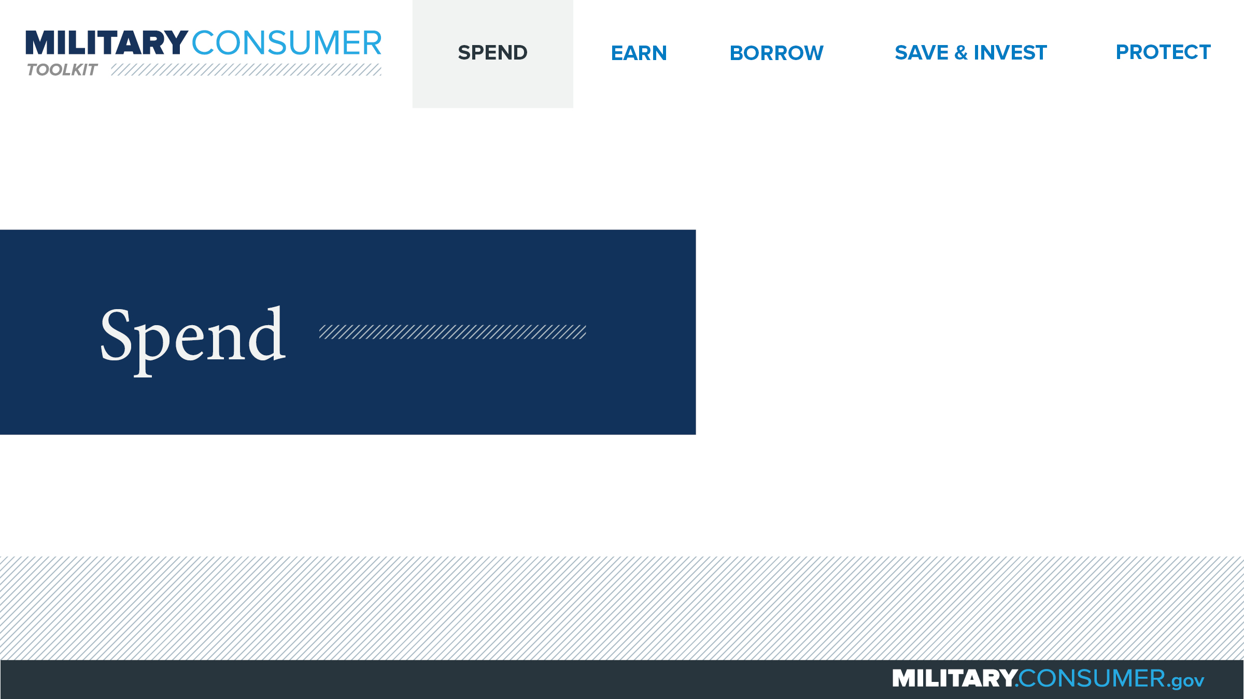
Notes:
Suggested Script:
Spending money is a fact of life. But it’s best to do this in a way that is carefully researched and planned out. When you know where your money is going, you have the power.
Today, we will learn about [PRESENTER: CUSTOMIZE TO SUIT THE TOPICS YOU WILL COVER] people who are available to help you plan your spending, how to create and manage a budget and how to shop smart for purchases ranging from small to large.

Slide 4
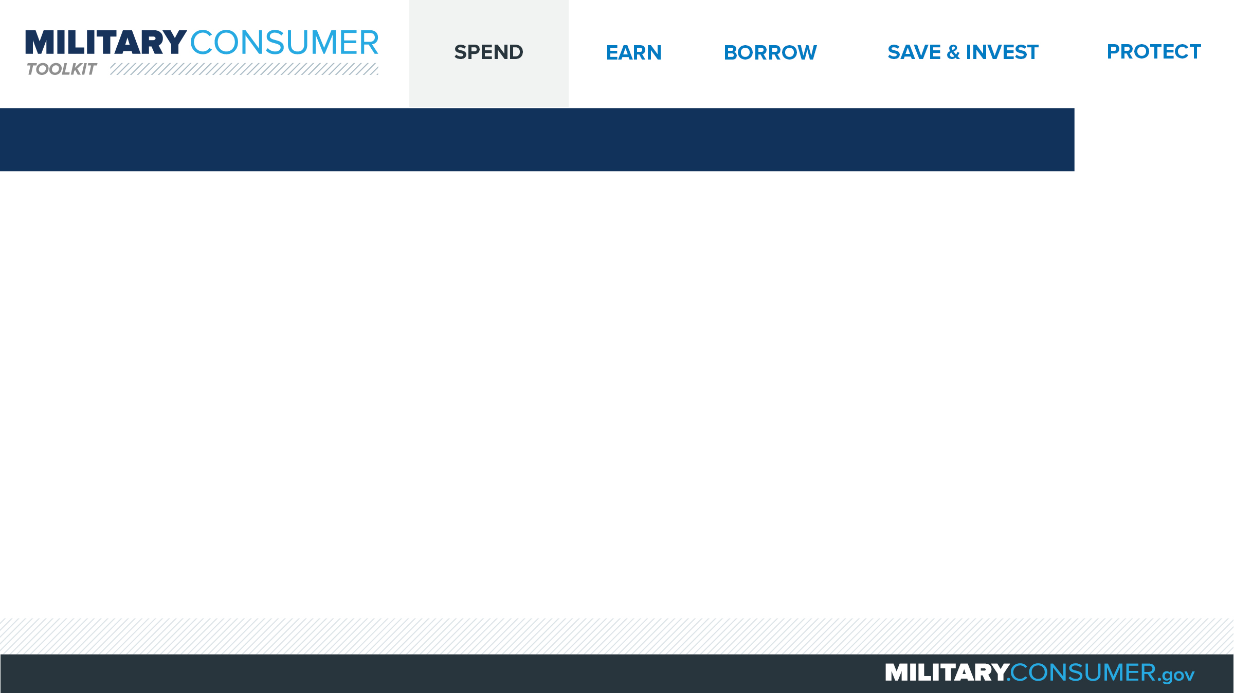
Buying a Car
Research
  Decide what you can afford
  Determine worth of your current car
  Decide how you will pay
  Do research before financing
Shop
  Choose the car and comparison shop
Buy
  Go to a dealer at the end of the month
  Focus on the “out the door” price
  Watch for add-ons or extra fees
  Lock in the total price first
  Remember – you can walk away
Notes:
Suggested Script:
How many of you have purchased a new car before?
Then you may know that doing research in advance is key to getting a good deal.
First, look at the total cost of the car, including fuel and insurance, as well as the down payment and monthly payments, to decide what you can afford.
Use a resource like Kelley Blue Book, Edmunds or the National Automobile Dealers Association’s Guides to determine how much your current car is worth.
Decide how you will pay for the car. If financing, do extensive research to understand your options.
Next, shop for the car. Decide what you want and research its features and price. Comparison shop for the car you’ve chosen by visiting websites and showrooms. And don’t forget to check the Exchange for special deals.
When it comes time to buy your car, try and go to the dealer at the end of the month, ideally at midweek. They’ll be more likely to make a deal then. As you negotiate, focus first on coming to agreement on the “out the door” price, keeping an eye out for unwanted add-ons or extra fees. Once that total price is locked in, you can discuss rebates, cash-back offers, trading in your old car and financing.
Remember, dealers expect you to negotiate. If at any time you feel pressured or decide you don’t like the deal, you can walk away and find another car and another deal.

Slide 5


