Slide 1


Slide 2
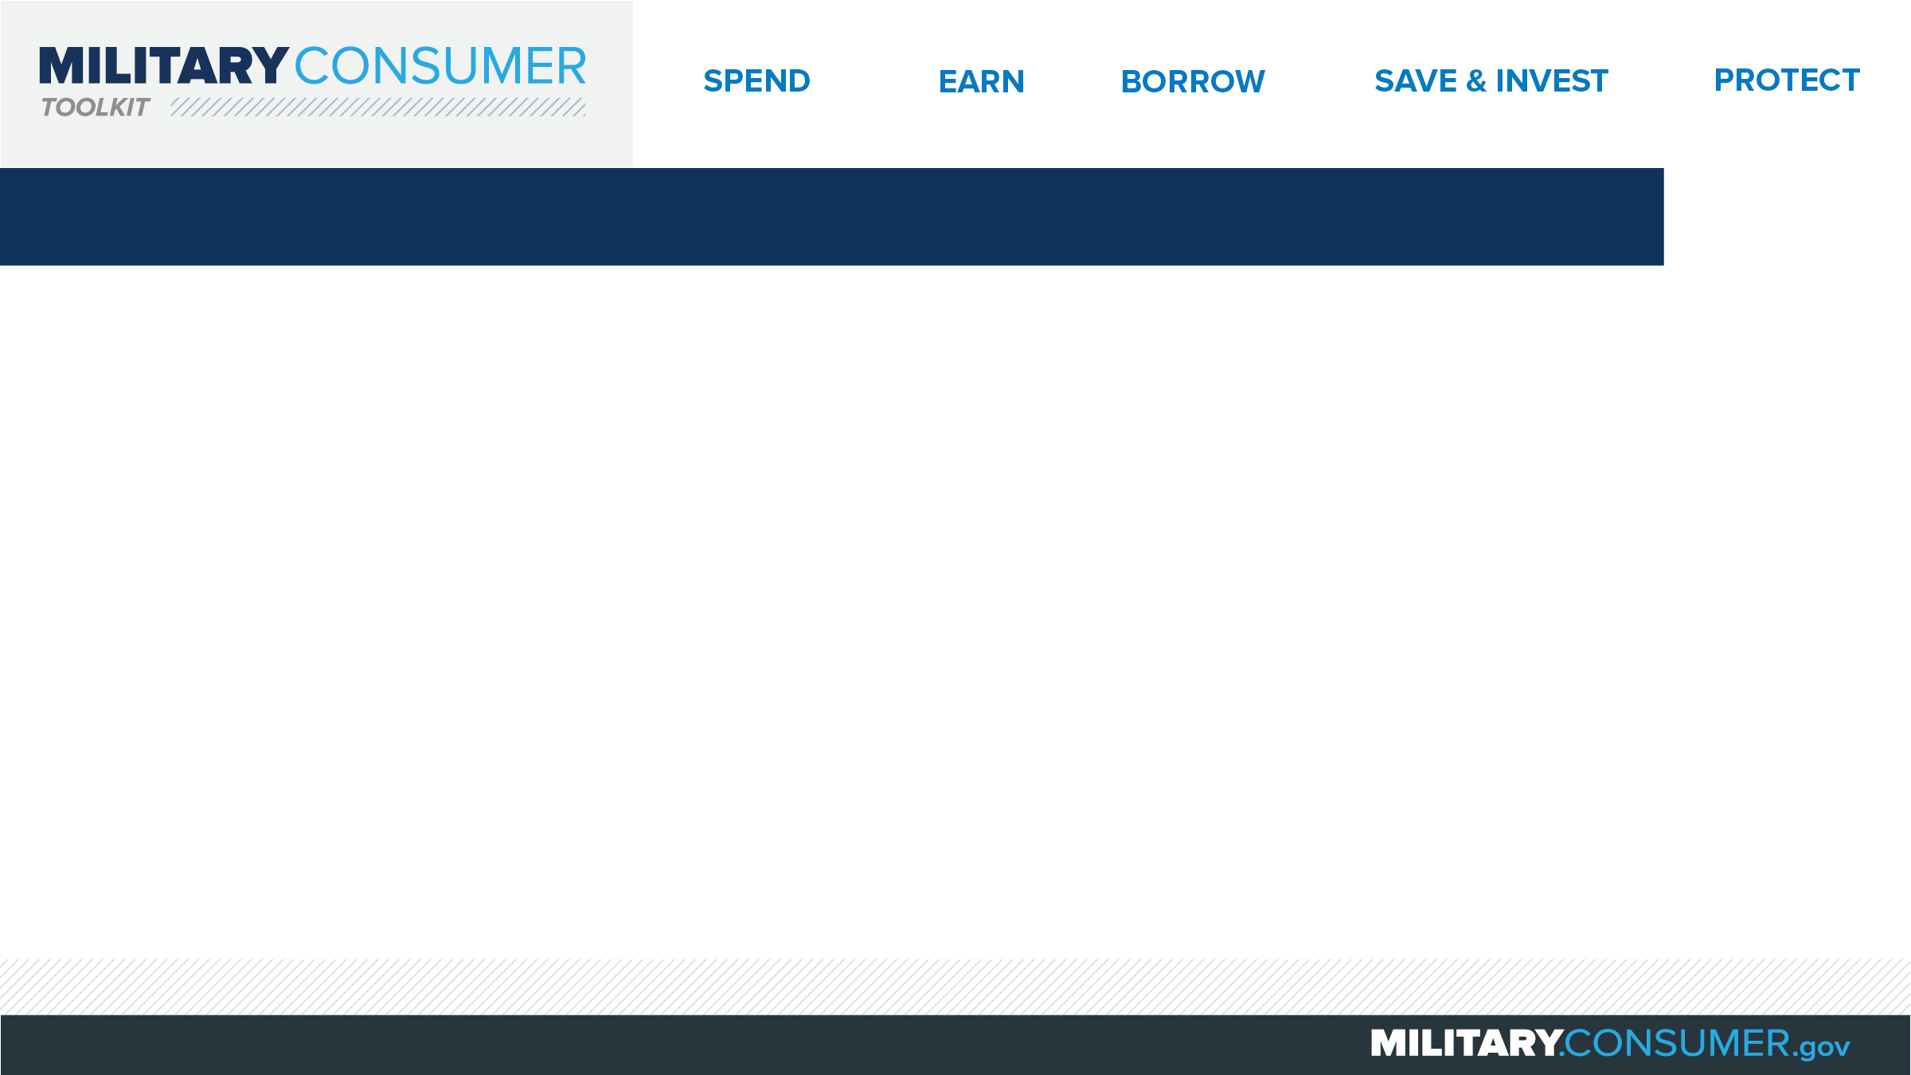
Why This Matters
Studies show that, on average, military families have higher amounts of debt and fewer assets than civilians
Challenges of military life can affect servicemembers’ finances:
  Frequent transition and changes
  Many servicemembers have little financial experience
  Decisions have long-term effects
Getting the know-how is key to making smart financial decisions
Notes:
[Presenter: Use this slide to set up the rest of your presentation, following it with slides that focus on the specific topics you want to cover.]
Suggested Script:
Today I’d like to talk about financial readiness – why it’s important and what you need to know to achieve it.
According to the National Foundation for Credit Counseling, active members of the military, veterans and their families have higher amounts of credit card debt and fewer assets than civilians. This means that military families are less equipped than their civilian counterparts to have the money they need for a secure future.
This is caused by many factors. As you know, military life is full of events and transitions, and each of these events brings the need to make important financial decisions. Unfortunately, many servicemembers – especially those without much financial experience – lack the information they need to make the right choices. This is particularly scary because many of these decisions can have long-term effects on a servicemember’s security clearance, mission readiness and family life.
Understanding your finances is your first line of defense. That’s why I’m here today – to help provide you with practical tips and information that will help you feel prepared to make these critical decisions.

Slide 3
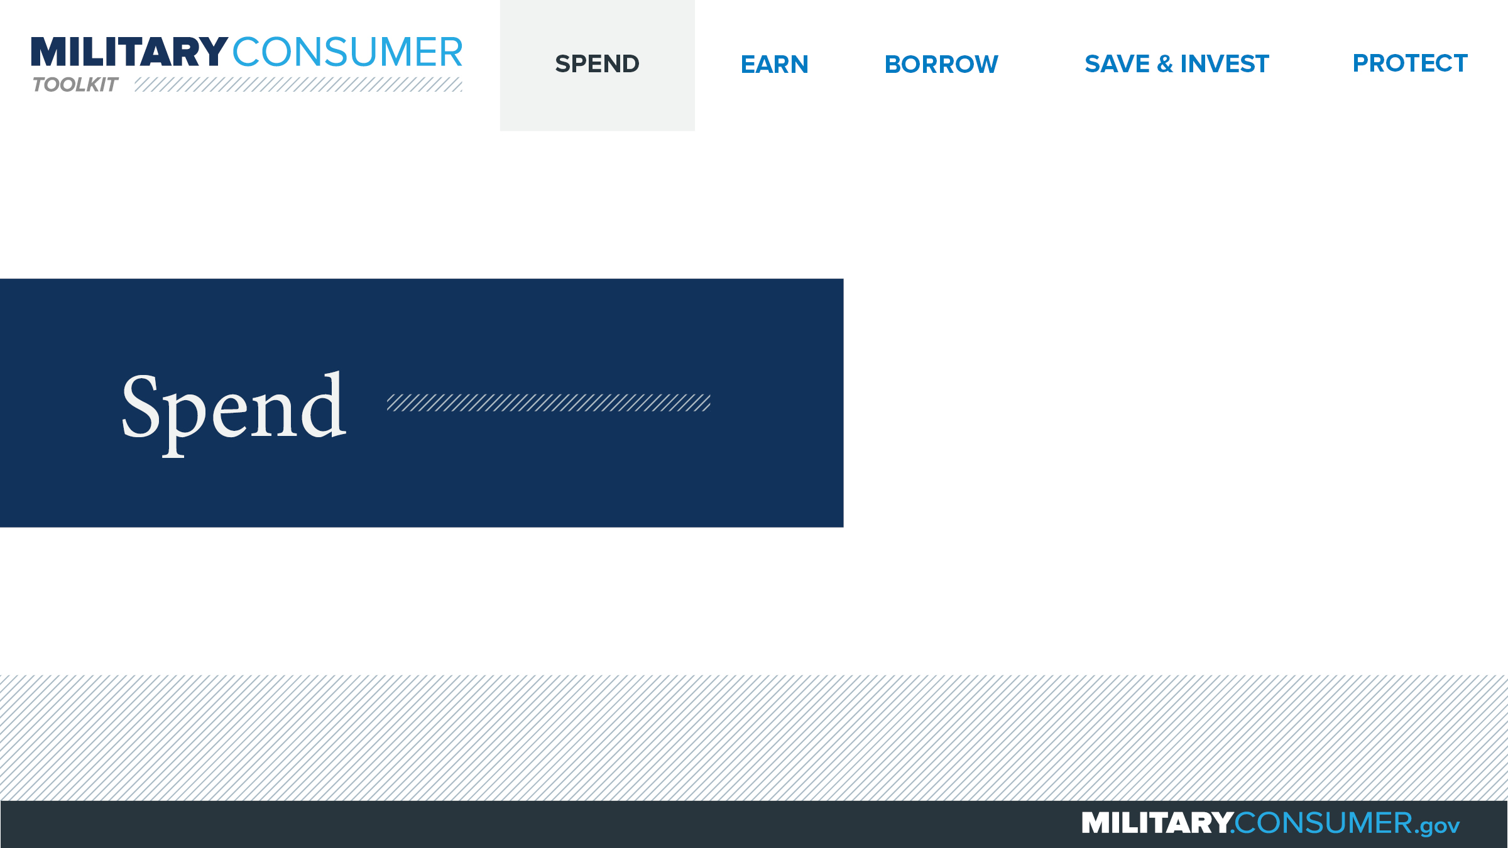
Notes:
Suggested Script:
Spending money is a fact of life. But it’s best to do this in a way that is carefully researched and planned out. When you know where your money is going, you have the power.
Today, we will learn about [PRESENTER: CUSTOMIZE TO SUIT THE TOPICS YOU WILL COVER] people who are available to help you plan your spending, how to create and manage a budget and how to shop smart for purchases ranging from small to large.

Slide 4
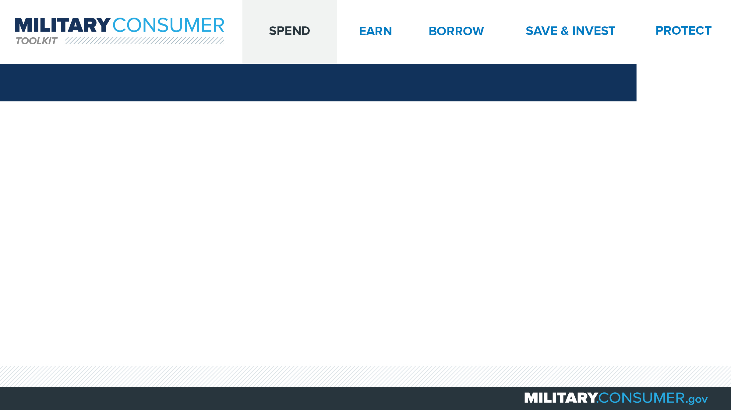
Used Car Buyers Guide and Warranties
Save you money and headaches
Buyers Guide tells you if the car:
  Is sold “as-is”
  Is sold with an implied warranty
  Has a warranty and if it’s full or partial
  Is under the manufacturer’s warranty
  Has a service contract available
Compare and negotiate
Ask for and keep documents
Notes:
Suggested Script:
Understanding what kind of warranty a used car comes with can save you money and headaches later on.
All dealers are required to post Buyers Guides for the used cars they sell. This document will tell you about the warranty – if there is one – and what it covers, including:
If the car is sold “as-is,” which means you will pay for any and all repairs.
If the car is sold with an implied warranty, which means that the dealer will pay for serious problems that weren’t clear when you bought the car
If there is a warranty, whether it is full or partial, what it covers and who pays for how much of any repairs.
If the car is under the manufacturer’s warranty.
If a service contract is available for the car and whether it transfers.
Once you have a full sense of this information, use it to compare and negotiate warranty coverage until you feel comfortable.
After purchasing a car, ask for the car’s warranty documents from the dealer. Also, keep the final Buyers Guide that was posted in the vehicle, since it’s what determines the warranty you get.

Slide 5


