Slide 1
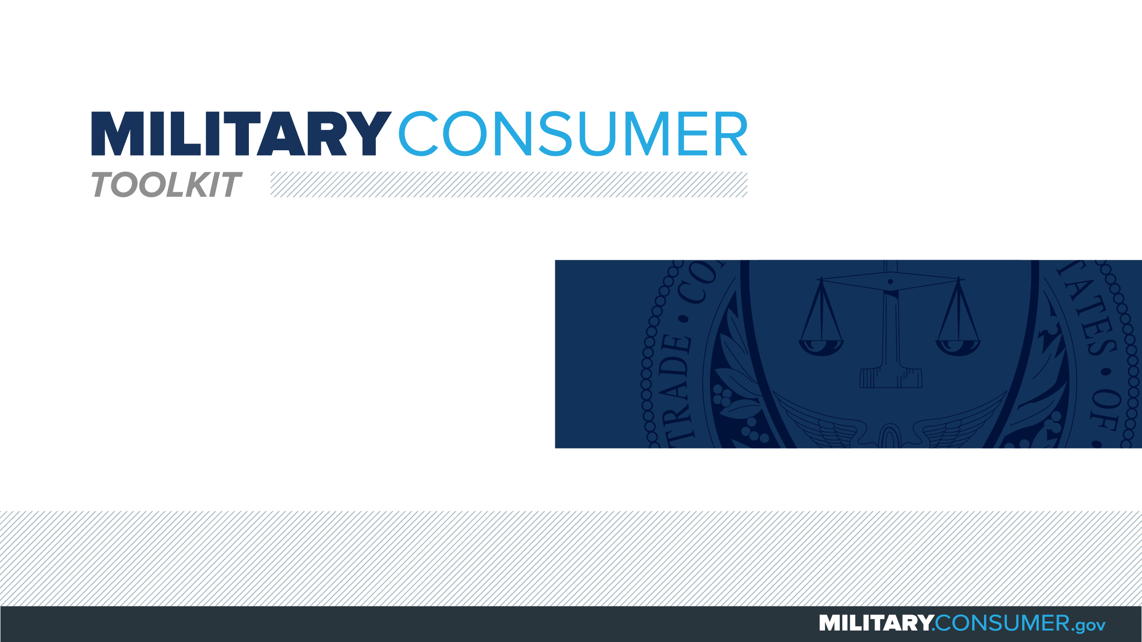

Slide 2
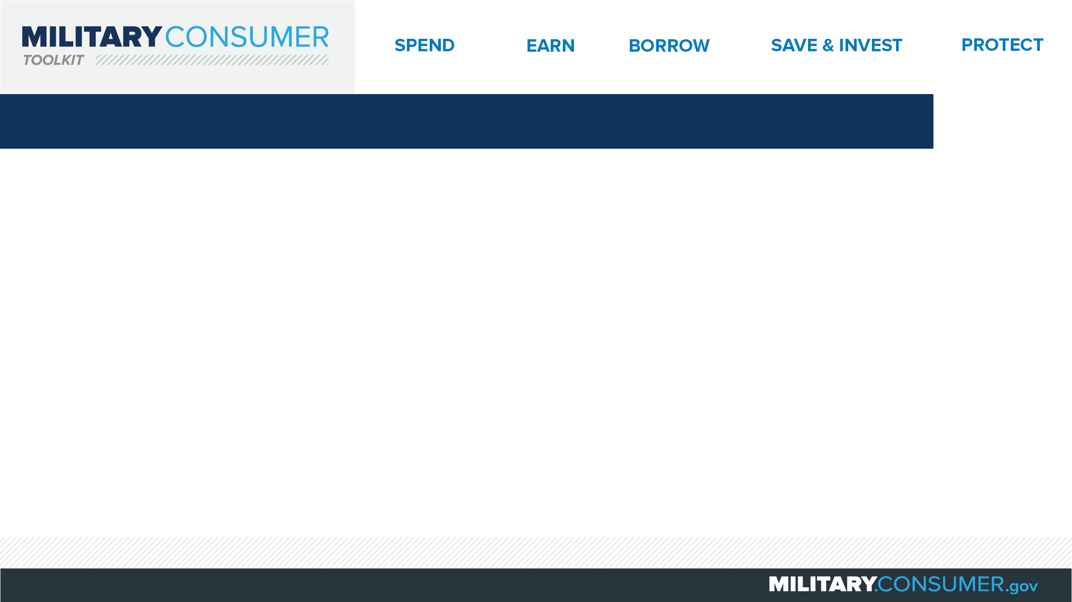
Why This Matters
Studies show that, on average, military families have higher amounts of debt and fewer assets than civilians
Challenges of military life can affect servicemembers’ finances:
  Frequent transition and changes
  Many servicemembers have little financial experience
  Decisions have long-term effects
Getting the know-how is key to making smart financial decisions
Notes:
[Presenter: Use this slide to set up the rest of your presentation, following it with slides that focus on the specific topics you want to cover.]
Suggested Script:
Today I’d like to talk about financial readiness – why it’s important and what you need to know to achieve it.
According to the National Foundation for Credit Counseling, active members of the military, veterans and their families have higher amounts of credit card debt and fewer assets than civilians. This means that military families are less equipped than their civilian counterparts to have the money they need for a secure future.
This is caused by many factors. As you know, military life is full of events and transitions, and each of these events brings the need to make important financial decisions. Unfortunately, many servicemembers – especially those without much financial experience – lack the information they need to make the right choices. This is particularly scary because many of these decisions can have long-term effects on a servicemember’s security clearance, mission readiness and family life.
Understanding your finances is your first line of defense. That’s why I’m here today – to help provide you with practical tips and information that will help you feel prepared to make these critical decisions.

Slide 3
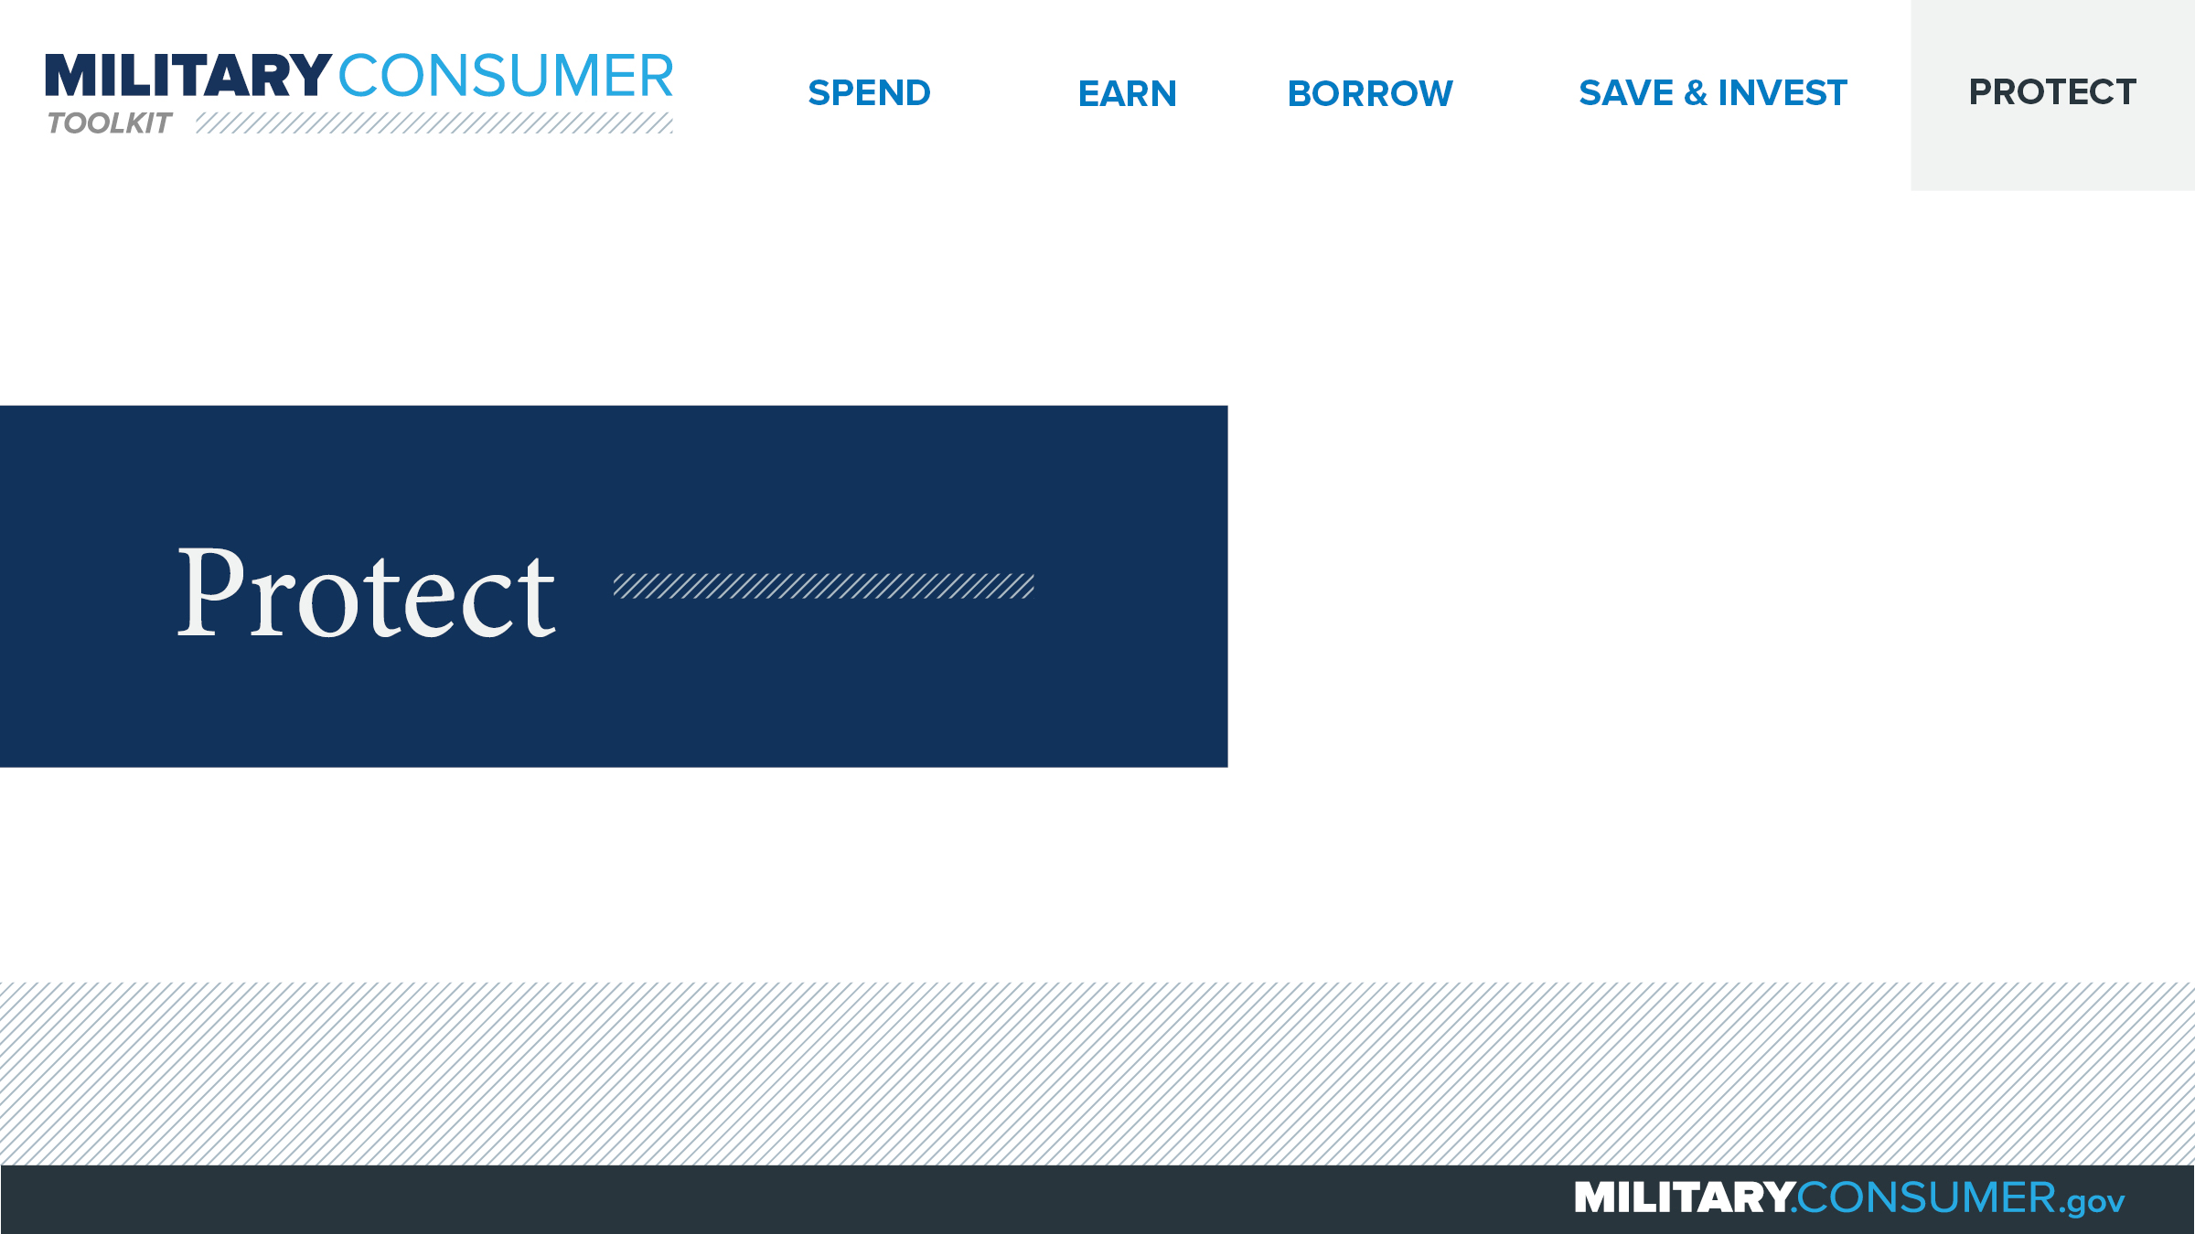
Notes:
Suggested Script:
With your financial situation in order, the last thing you want to do is have it be jeopardized by thieves and scammers.
Today, we’ll learn some actionable tips for keeping your finances safe, including [PRESENTER: CUSTOMIZE TO SUIT THE TOPICS YOU WILL COVER] how to safeguard your money, personal information, financial records and reputation.

Slide 4
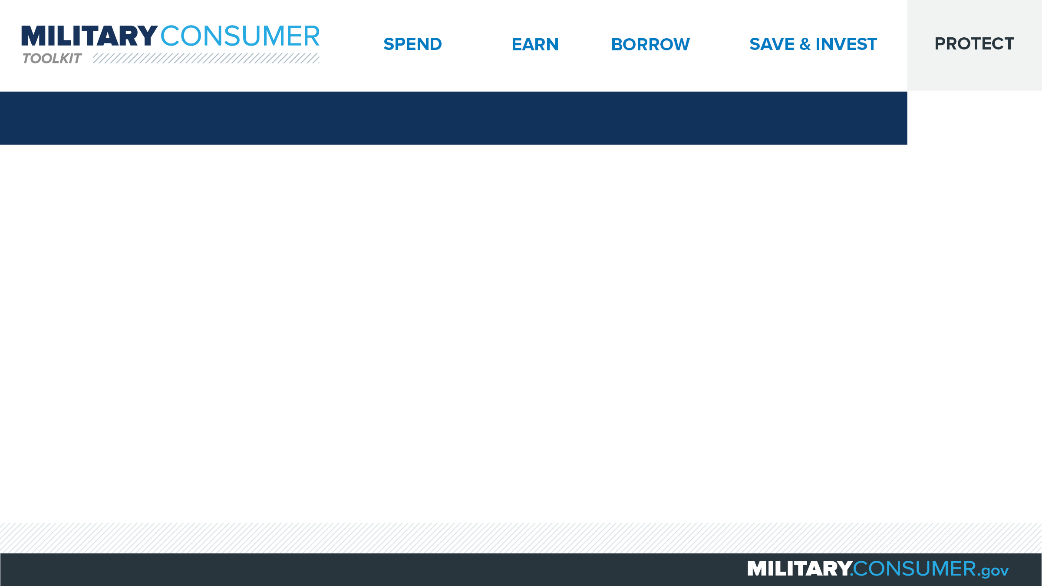
Protecting Your Personal Information
Use strong passwords
Choose unique security questions
Use multi-factor authentication
Share SSN and account info judiciously
Beware of imposters
Lock up, shred sensitive documents
Info compromised? Visit IdentityTheft.gov
Notes:
Suggested Script:
You can only control what happens to your personal information as long as it’s in your possession. Here are seven simple tips for doing just that:
First, create strong passwords. The best passwords are at least 12 characters long and use a combination of uppercase and lowercase letters, numbers and symbols. Put non-lowercase letters in the middle and avoid common words or phrases. Have trouble remembering your passwords? Consider using a password manager.
Choose security questions only you can answer. Avoid using questions that can be answered through a simple search of public records (e.g., your zip code, birthplace, mother’s maiden name) or possess a limited number of responses that can be easily guessed through the process of elimination (e.g., the color of your first car).
Use multi-factor authentication, when available. More websites are requiring you to enter a combination of authentication factors before logging in. Factors could include a password plus a code texted to a mobile phone or a fingerprint.
Only share your Social Security and other account numbers (credit card, bank, utility) judiciously. Whenever someone asks you for your personal information, ask yourself “can I trust them?” And never share your personal information via social networking channels or public websites.
Beware of imposters. If you’re not sure if the person or company contacting you is legitimate, hang up or don’t reply. Do your own research by looking up the main customer service number and contacting them independently to verify.
Store documents containing sensitive financial information in a secured location. And if you no longer need it, shred it.
Visit IdentityTheft.gov for assistance the moment you suspect suspicious activity.

Slide 5
