Slide 1
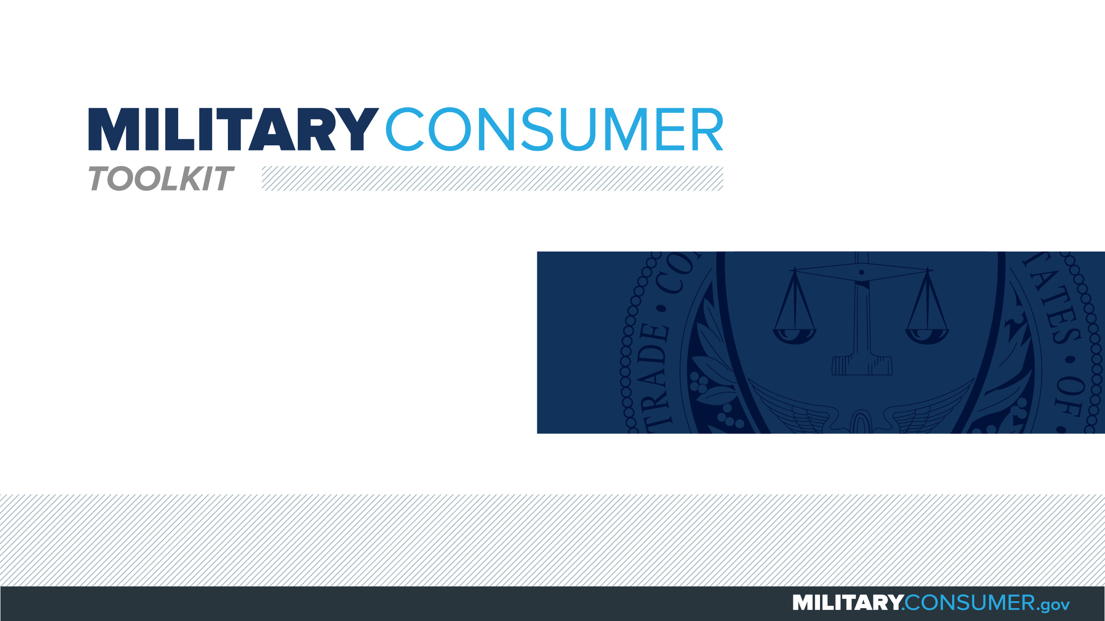

Slide 2
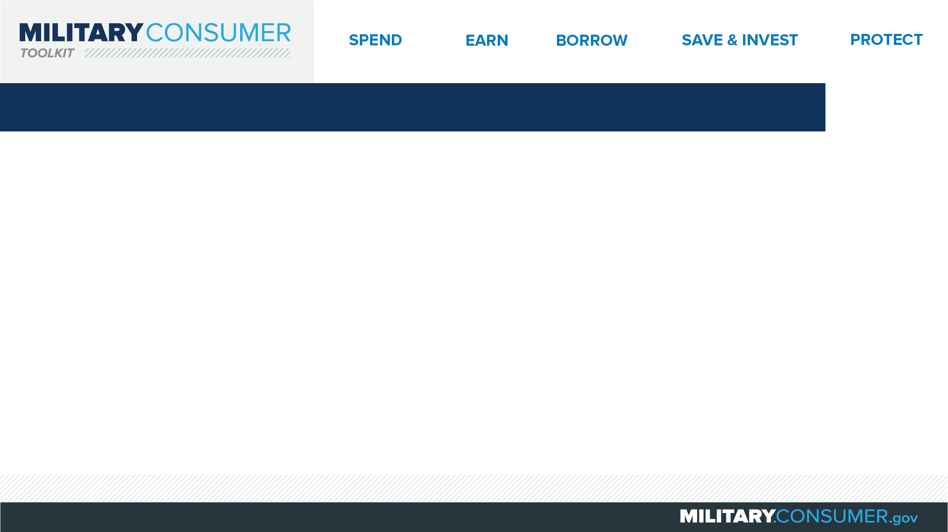
Why This Matters
Studies show that, on average, military families have higher amounts of debt and fewer assets than civilians
Challenges of military life can affect servicemembers’ finances:
  Frequent transition and changes
  Many servicemembers have little financial experience
  Decisions have long-term effects
Getting the know-how is key to making smart financial decisions
Notes:
[Presenter: Use this slide to set up the rest of your presentation, following it with slides that focus on the specific topics you want to cover.]
Suggested Script:
Today I’d like to talk about financial readiness – why it’s important and what you need to know to achieve it.
According to the National Foundation for Credit Counseling, active members of the military, veterans and their families have higher amounts of credit card debt and fewer assets than civilians. This means that military families are less equipped than their civilian counterparts to have the money they need for a secure future.
This is caused by many factors. As you know, military life is full of events and transitions, and each of these events brings the need to make important financial decisions. Unfortunately, many servicemembers – especially those without much financial experience – lack the information they need to make the right choices. This is particularly scary because many of these decisions can have long-term effects on a servicemember’s security clearance, mission readiness and family life.
Understanding your finances is your first line of defense. That’s why I’m here today – to help provide you with practical tips and information that will help you feel prepared to make these critical decisions.

Slide 3
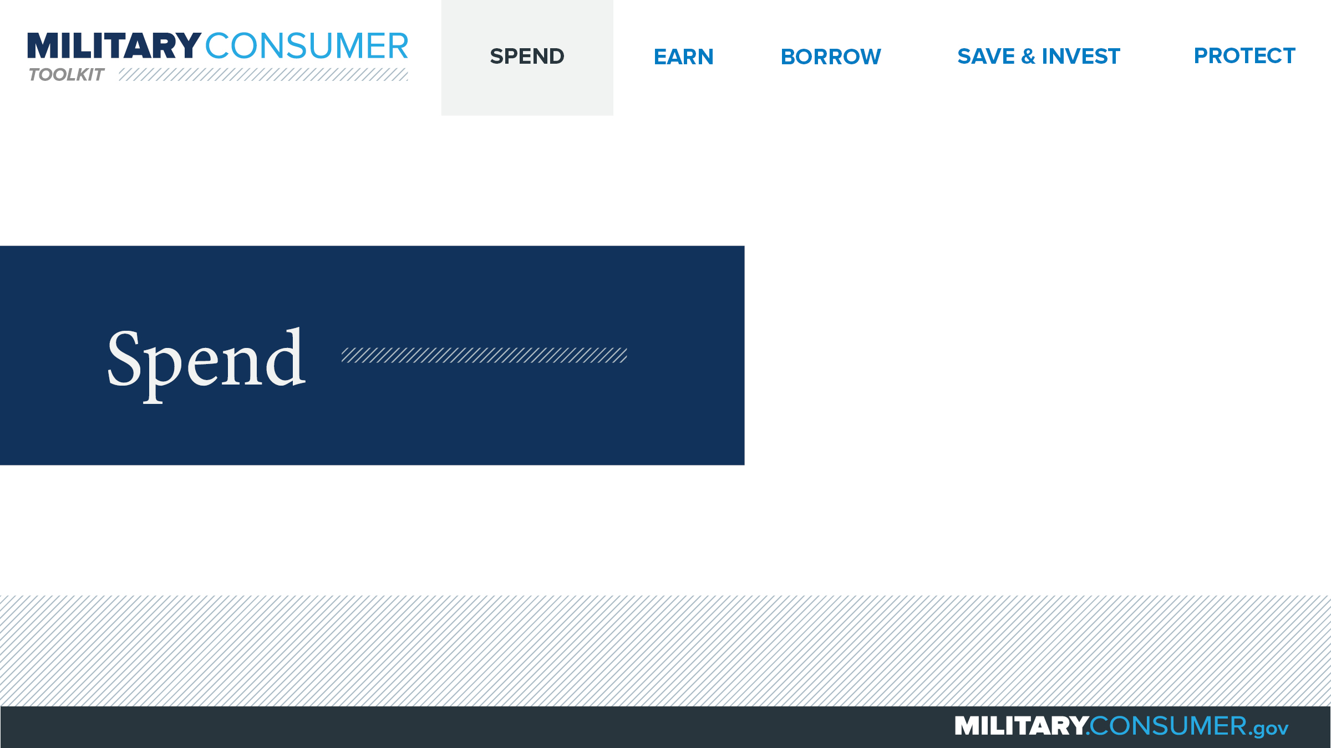
Notes:
Suggested Script:
Spending money is a fact of life. But it’s best to do this in a way that is carefully researched and planned out. When you know where your money is going, you have the power.
Today, we will learn about [PRESENTER: CUSTOMIZE TO SUIT THE TOPICS YOU WILL COVER] people who are available to help you plan your spending, how to create and manage a budget and how to shop smart for purchases ranging from small to large.

Slide 4
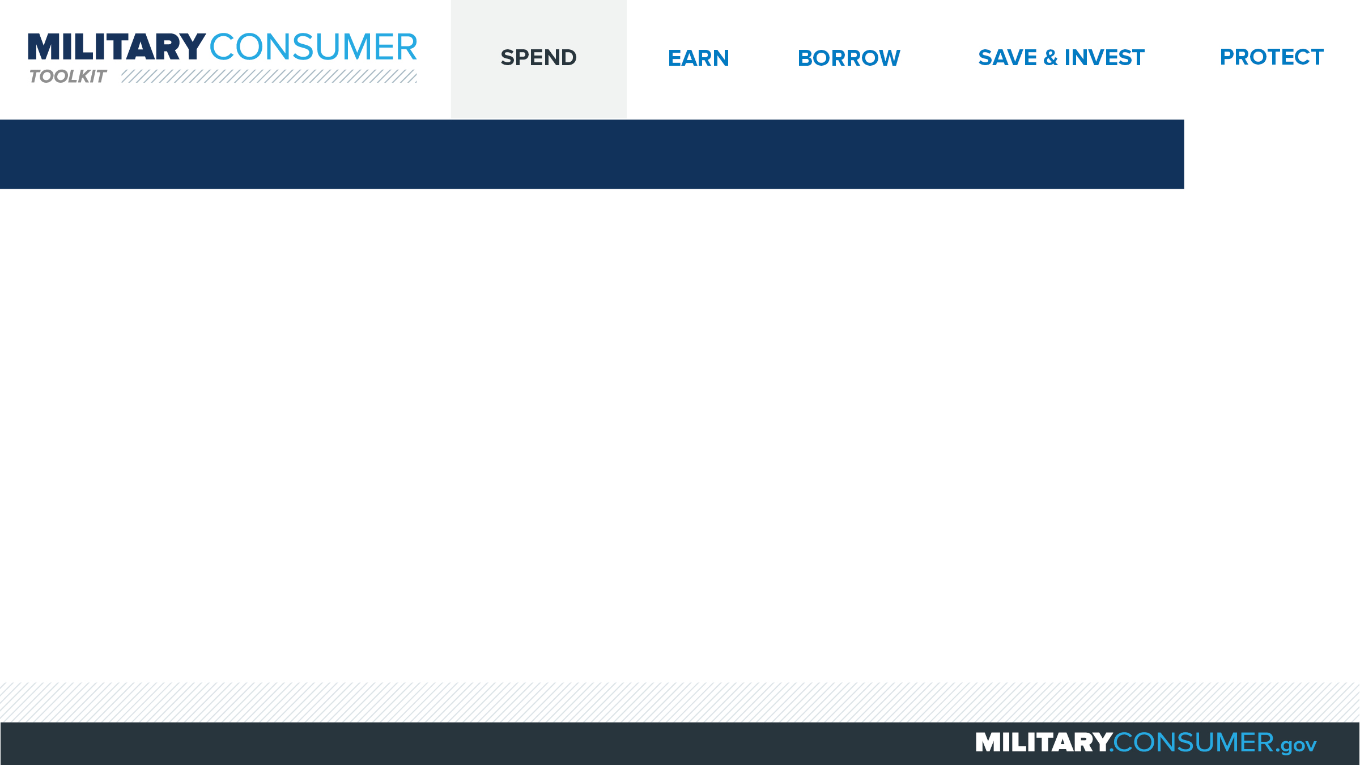
Buying a Used Car
Find a car
  Decide what you can afford
  Decide how you will pay
  Do research before financing
  Shop around
Check it out
  Test-drive
  Maintenance record
  Warranty
  Inspection
  Car history
Buy and enjoy (or walk away)
Notes:
Suggested Script:
Used cars can be great deals, but it’s critical that you do your research before buying.
Begin by finding a car that you like. First, look at the total cost of the car, including fuel and insurance, as well as the down payment and monthly payments, to determine your price range. Then consider how you will pay and, if financing, research your options. Then, use a website like Kelley Blue Book, Edmunds or the National Automobile Dealers Association’s Guides to shop around for a car in your price range.
Once you’ve found a car that you like, check it out before you buy. Test drive the car in a variety of different conditions, including on the highway and in stop-and-go traffic. Ask for the car’s maintenance records and determine whether the car is still under warranty or a service contract. Hire a mechanic you trust to look over the car and give it a full inspection. And research the car’s history at vehiclehistory.gov, as well as any recalls at safercar.gov and whether it was flood damaged or declared as salvage at nicb.org.
Remember, you always can walk away. But if all looks good, move forward with buying your car and enjoy your new purchase.

Slide 5


